Slide 1
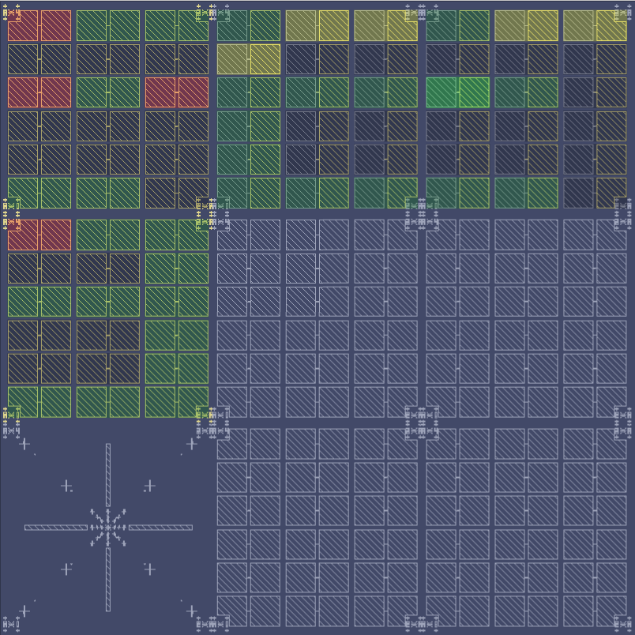
Sc51 dev01 ebl02 Ti-Ti Pd-Ti

Slide 2
Idvd

Slide 3
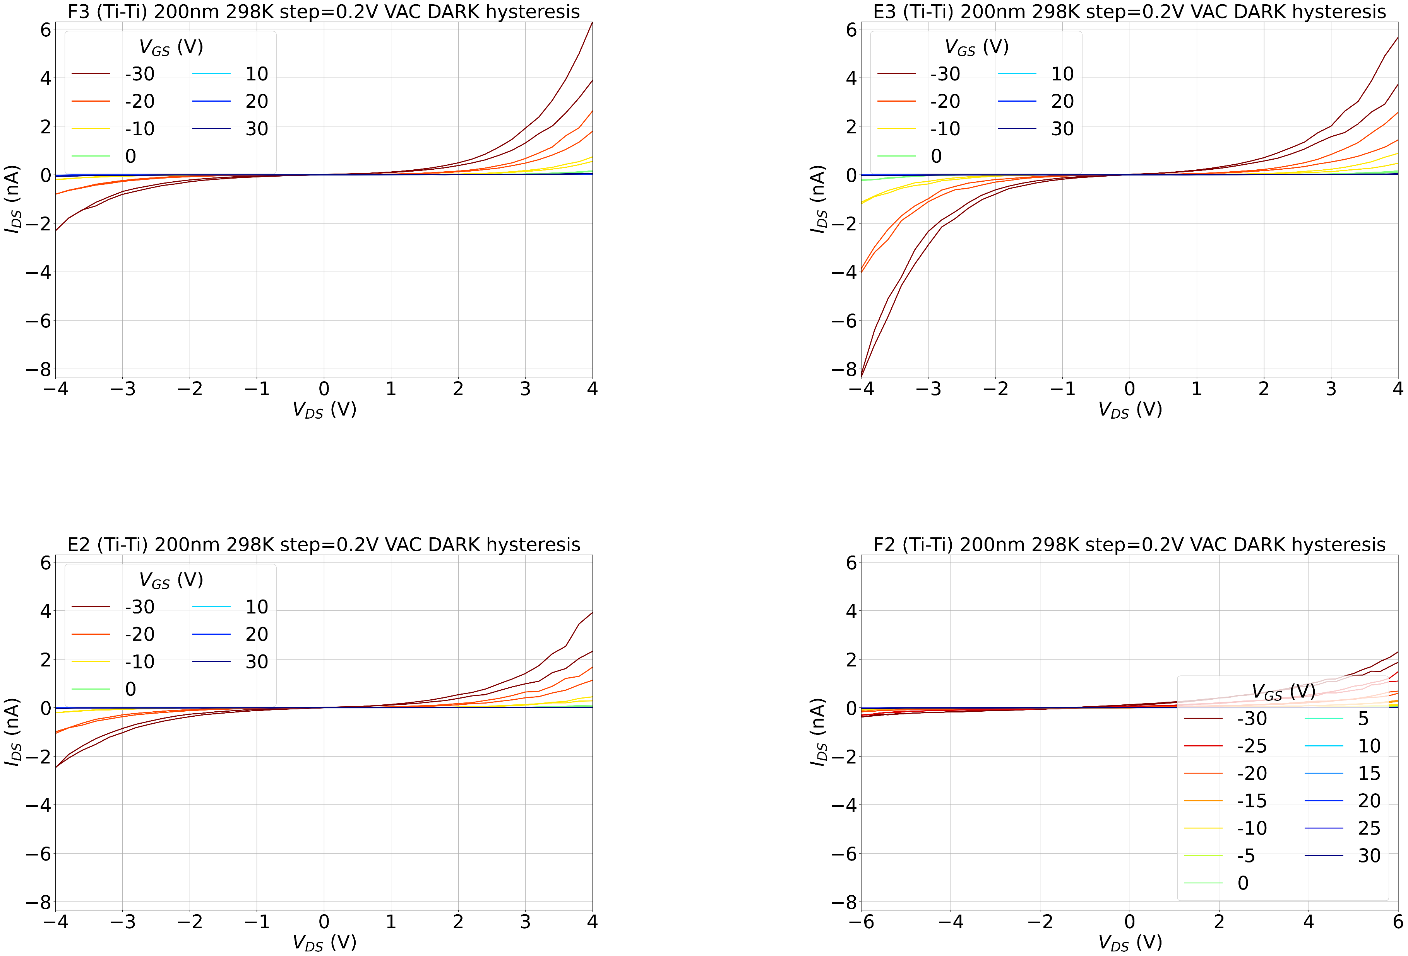
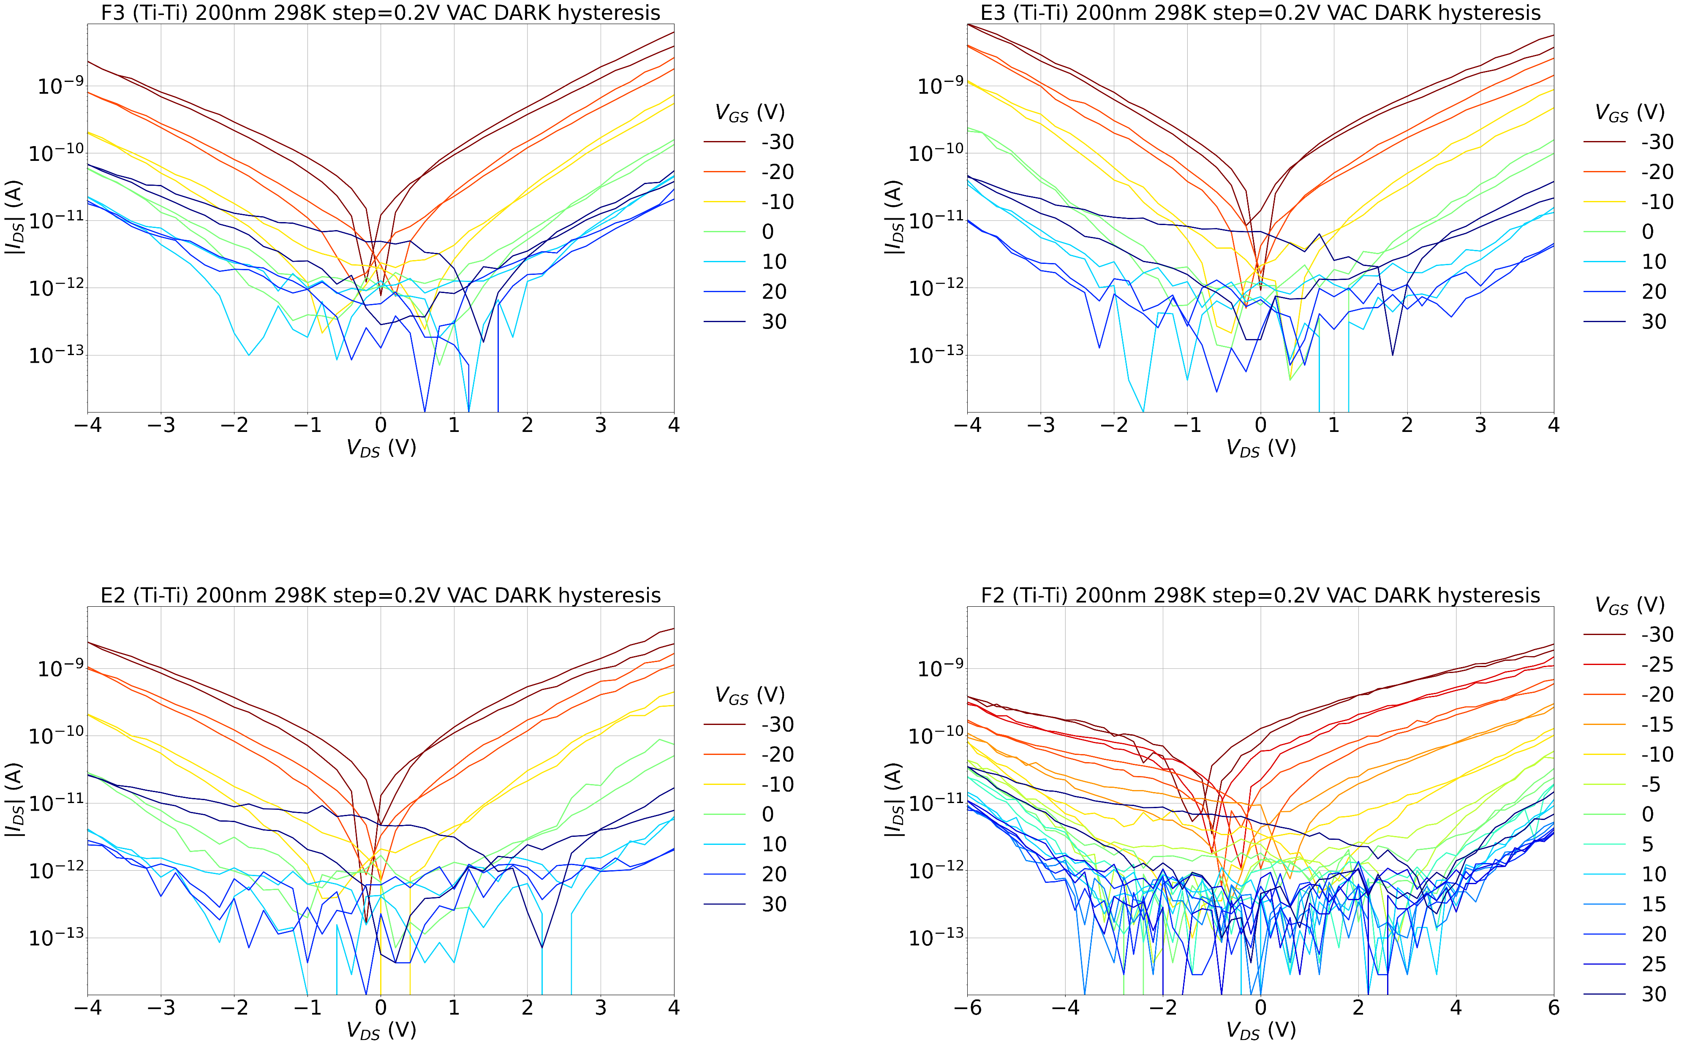
200nm Ti-Ti 298K

Slide 4
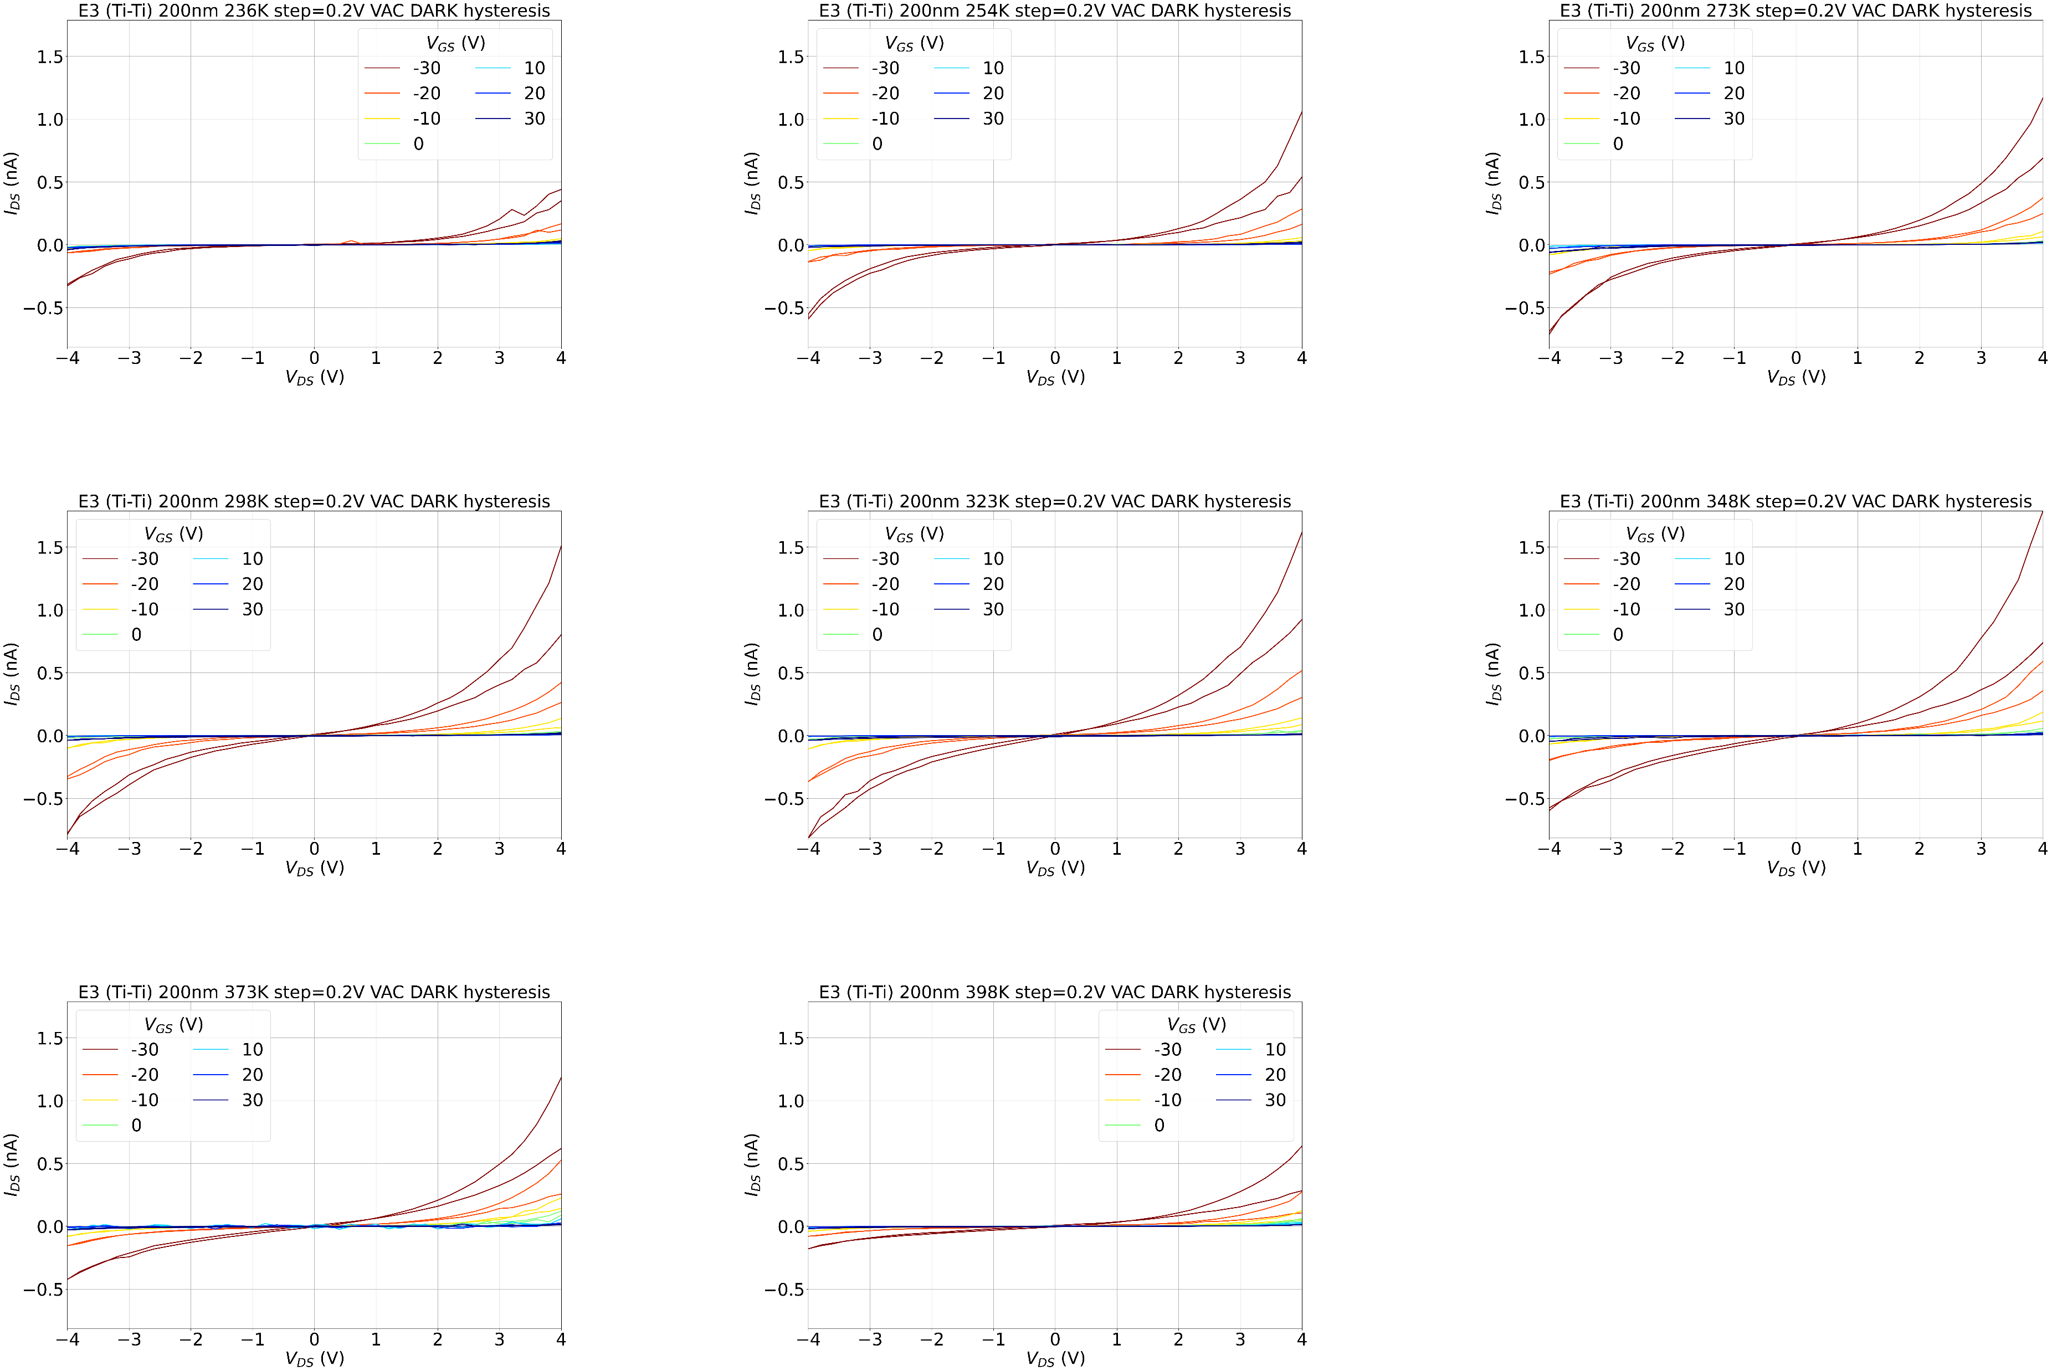
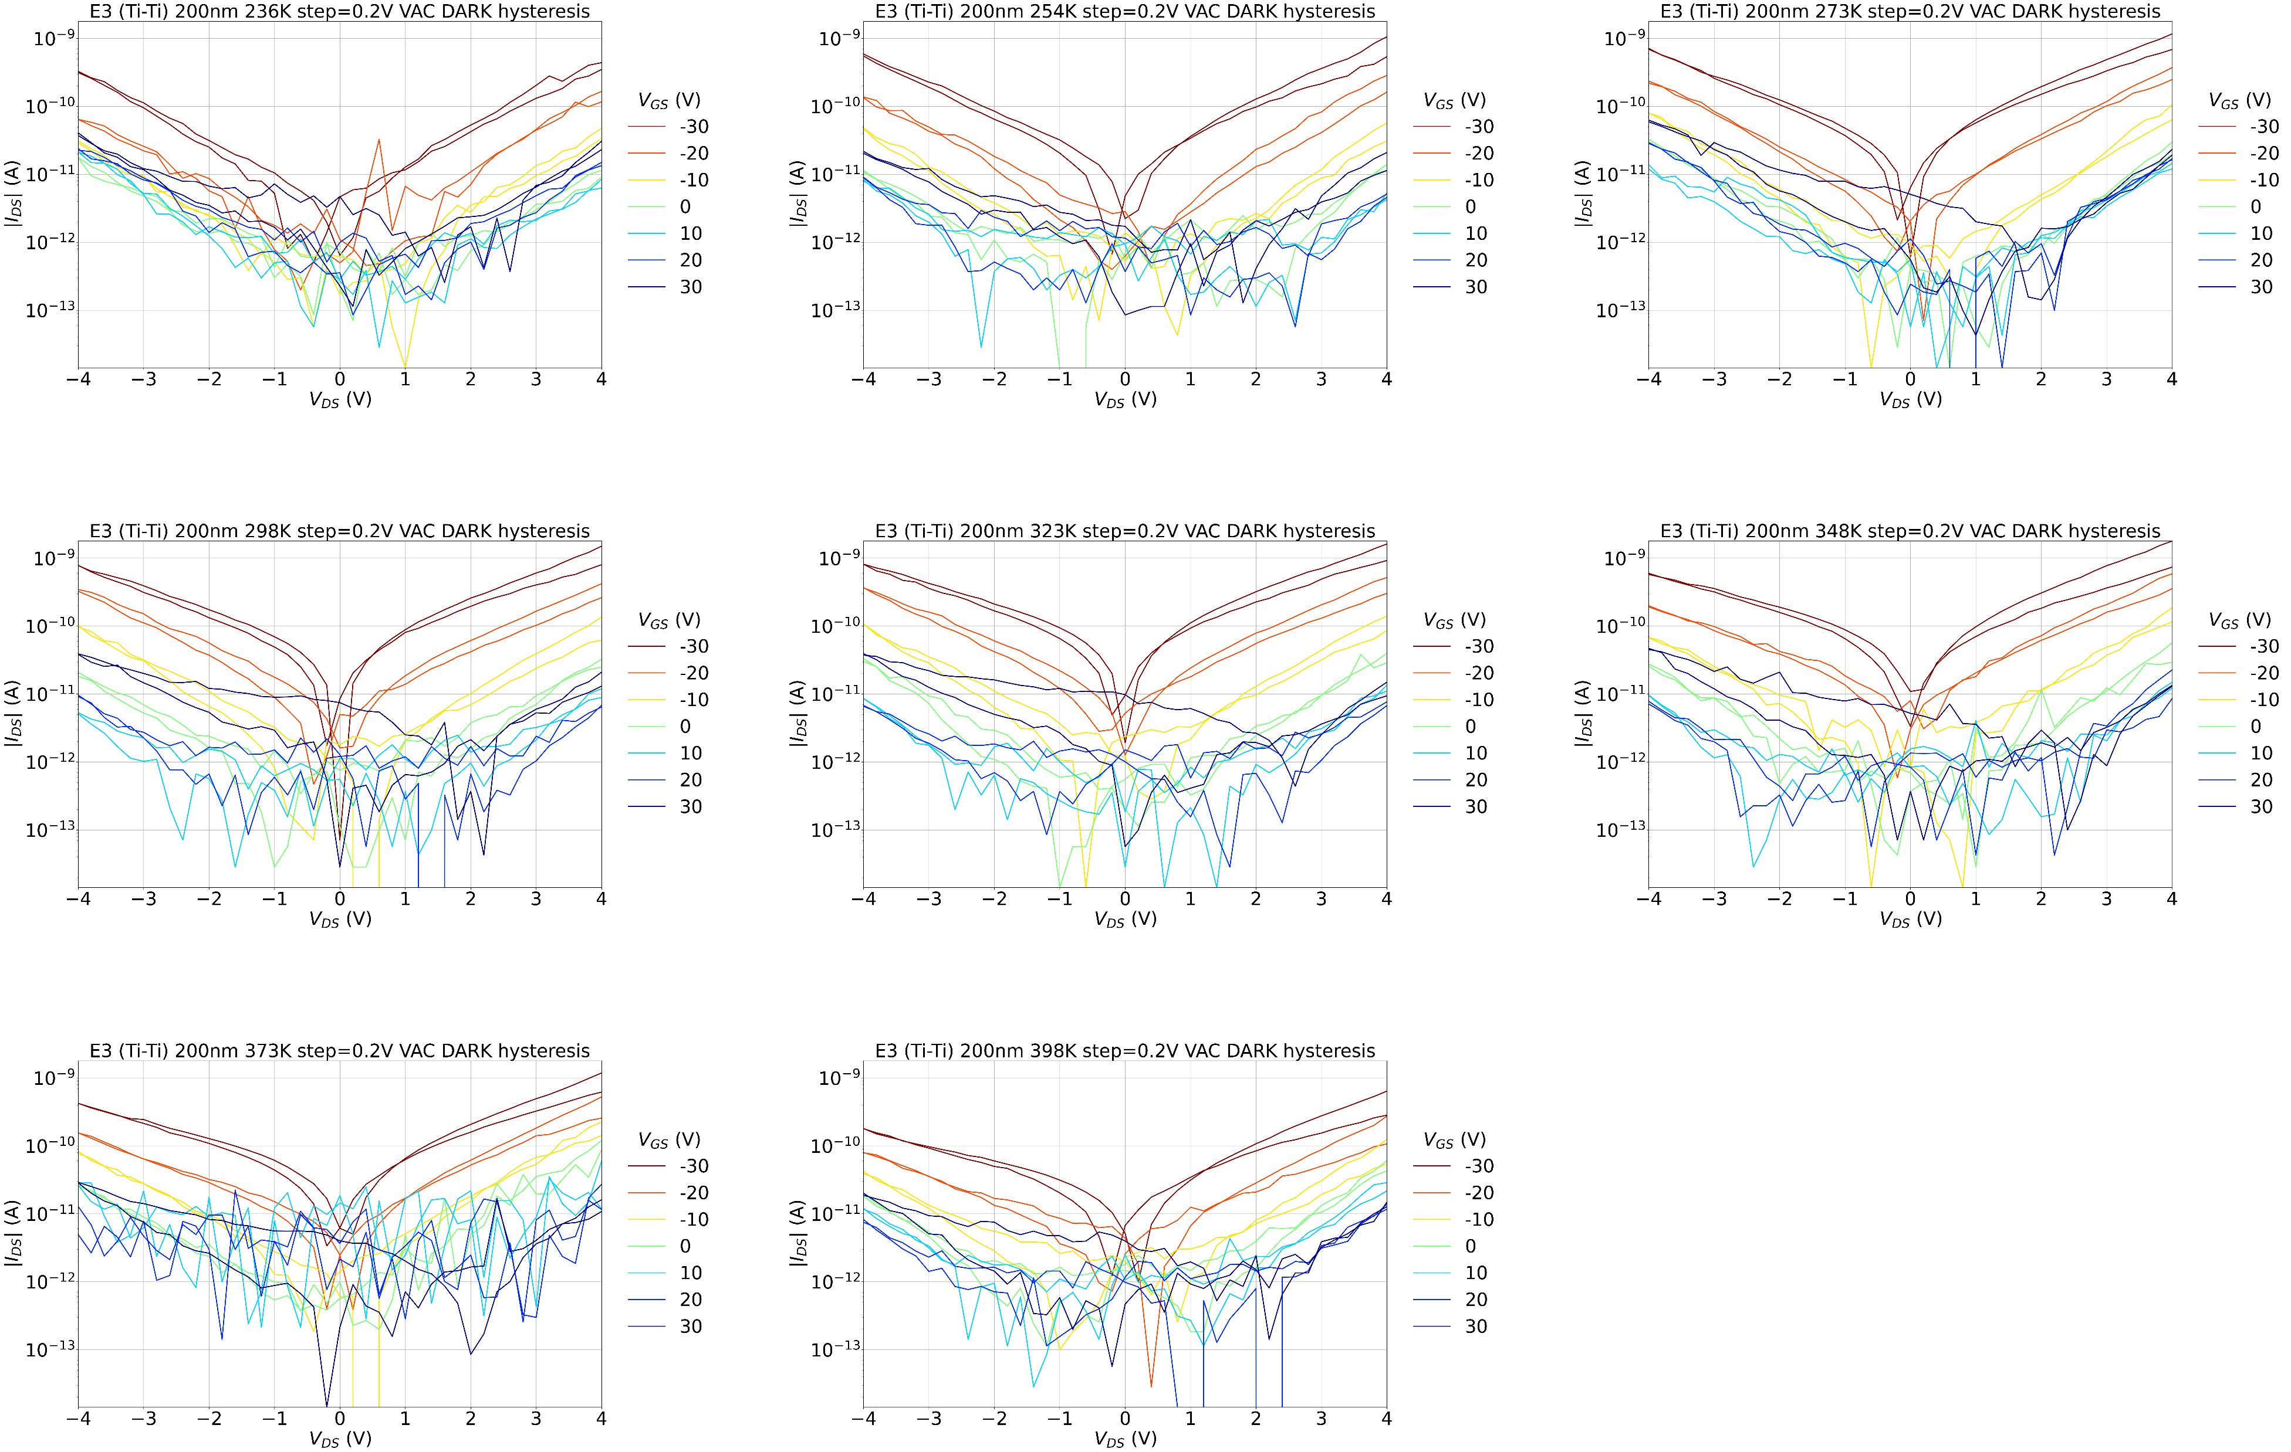
200nm Ti-Ti E3 T sweep

Slide 5
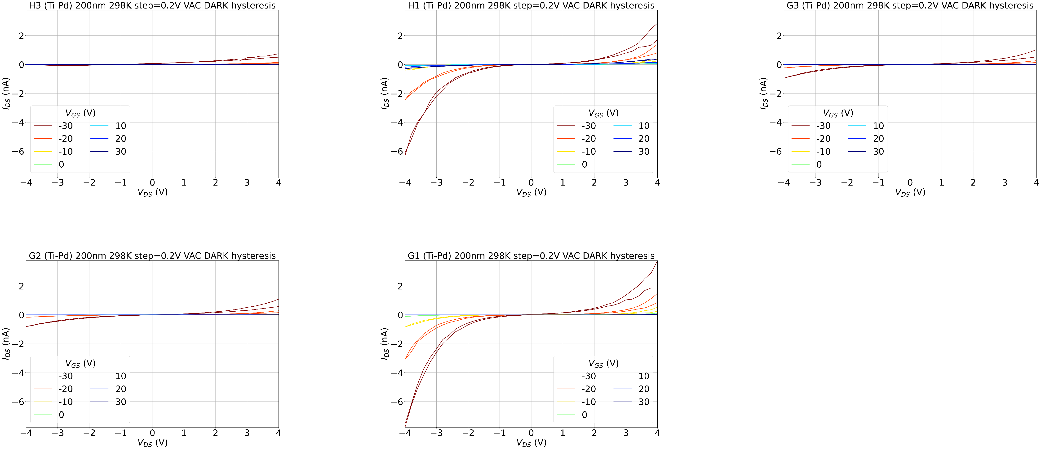
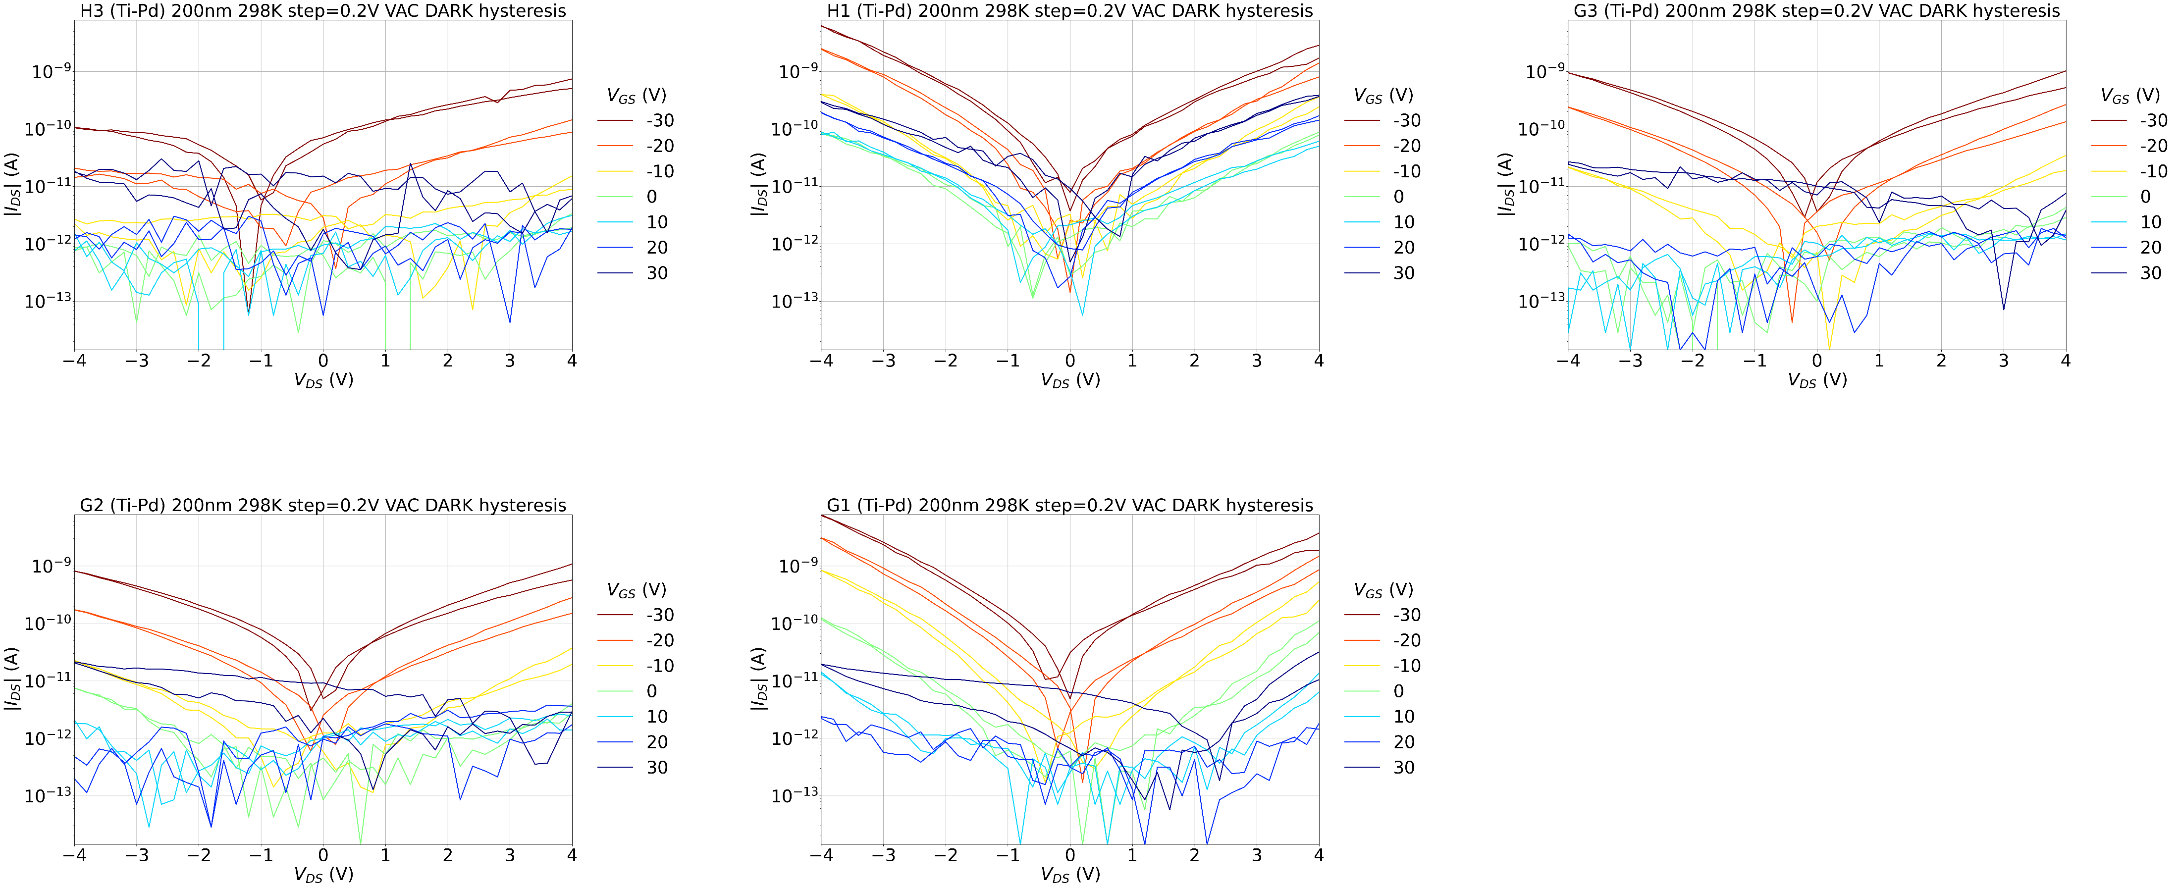
200nm Ti-Pd 298K

Slide 6
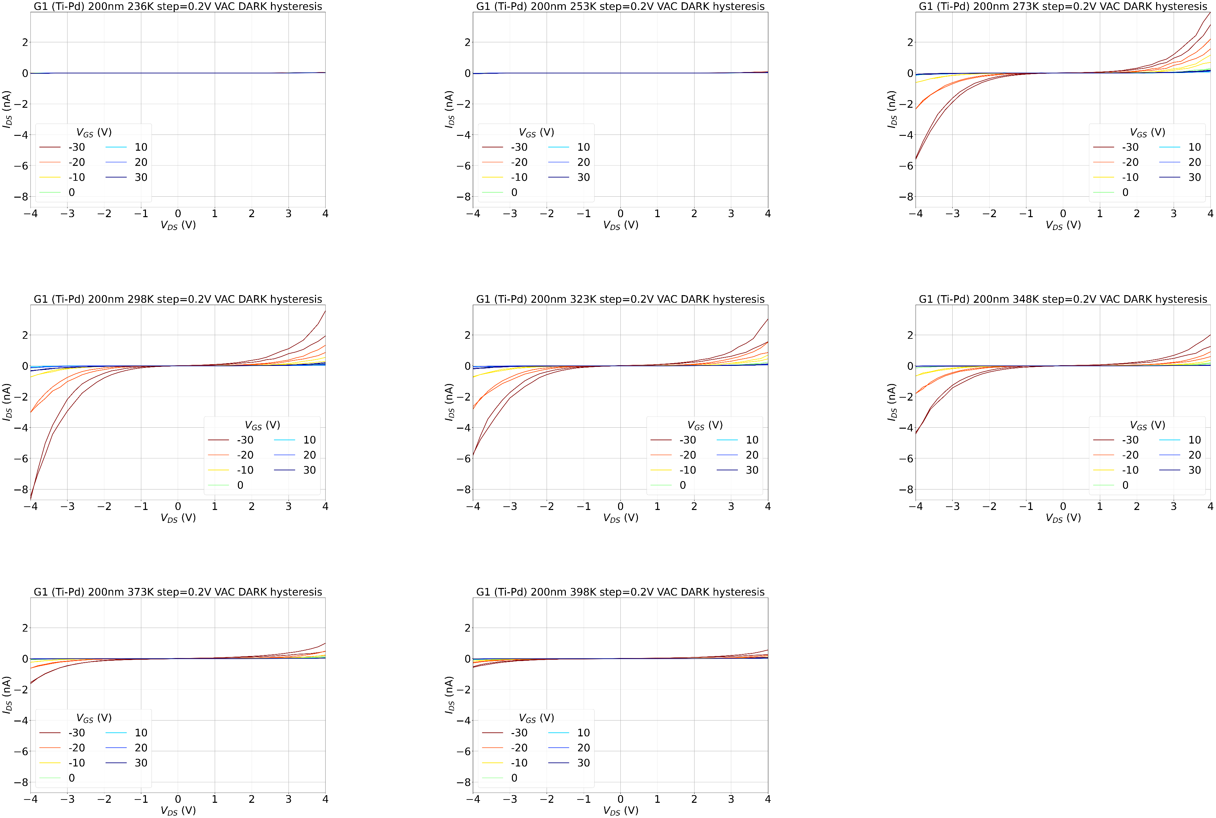
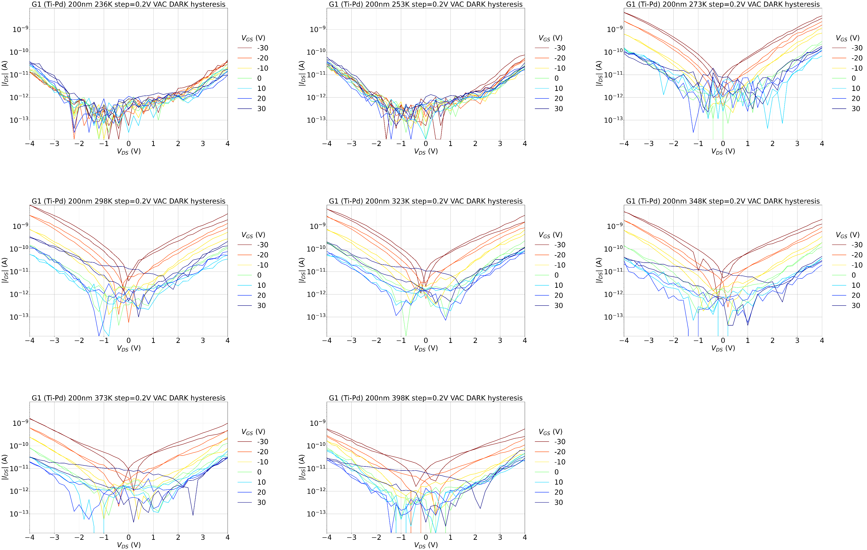
200nm Ti-Pd G1 T sweep

Slide 7
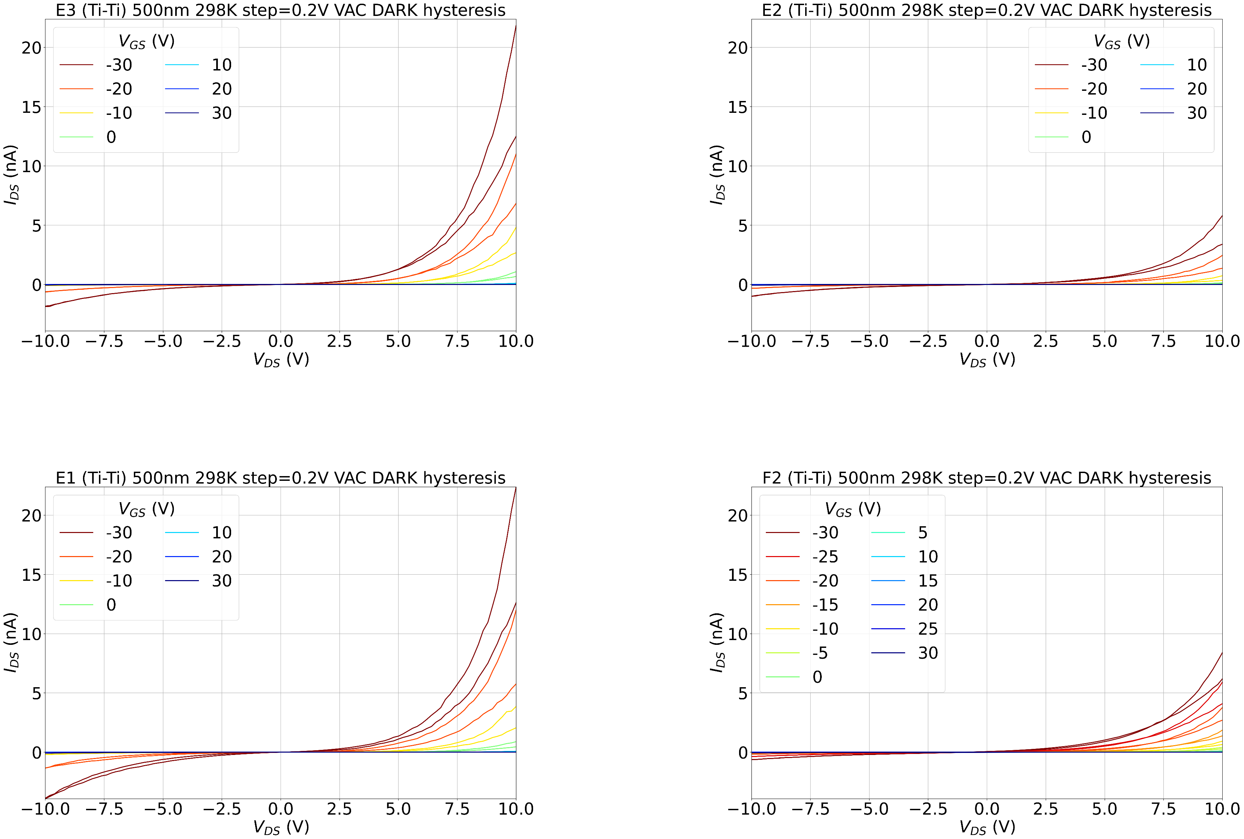
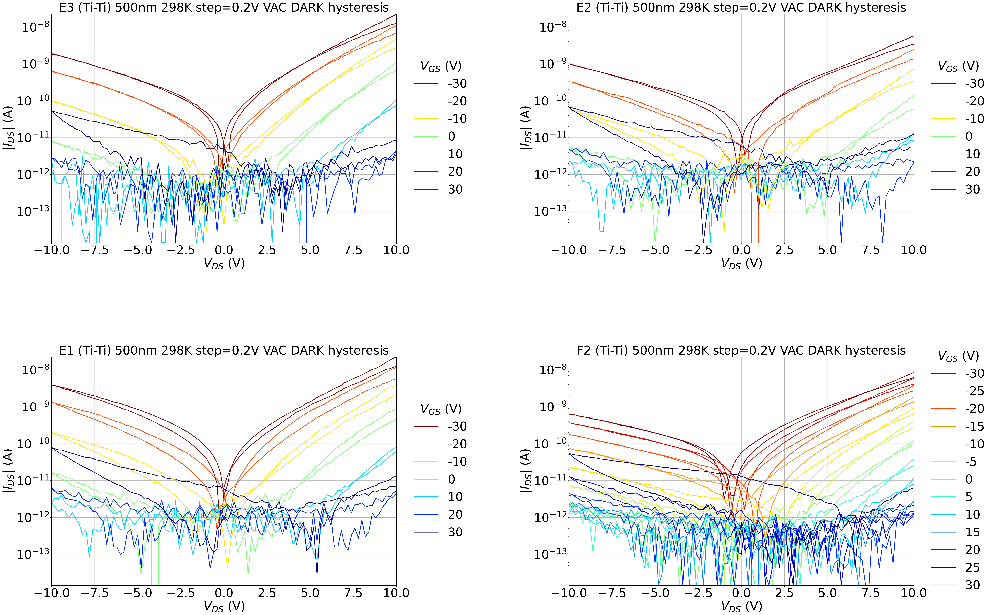
500nm Ti-Ti 298K

Slide 8
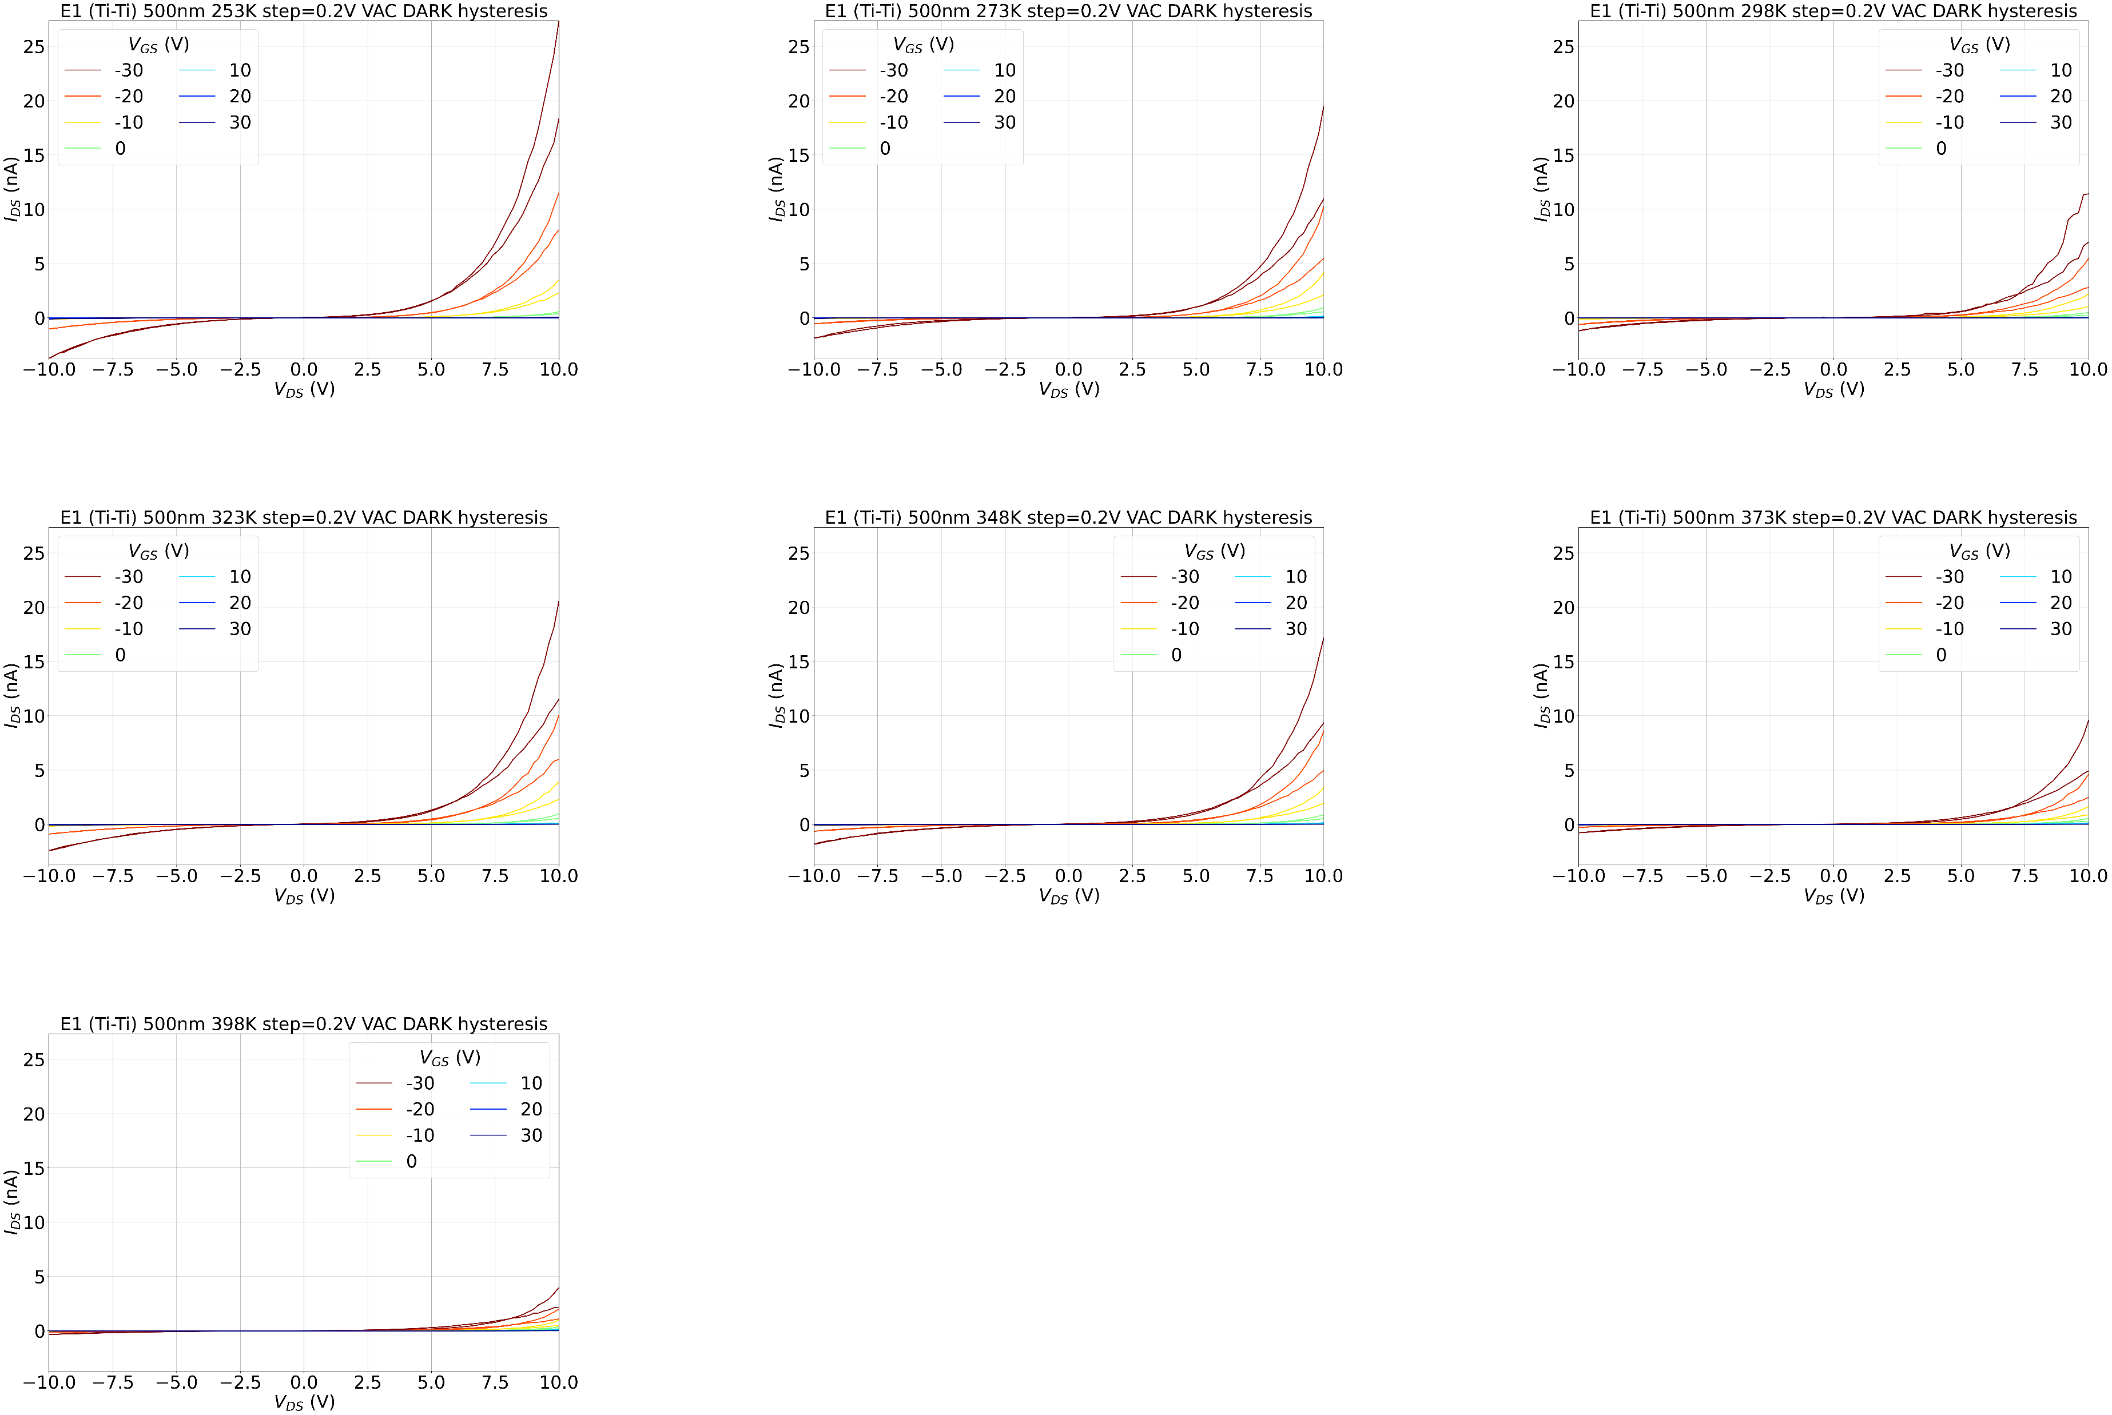
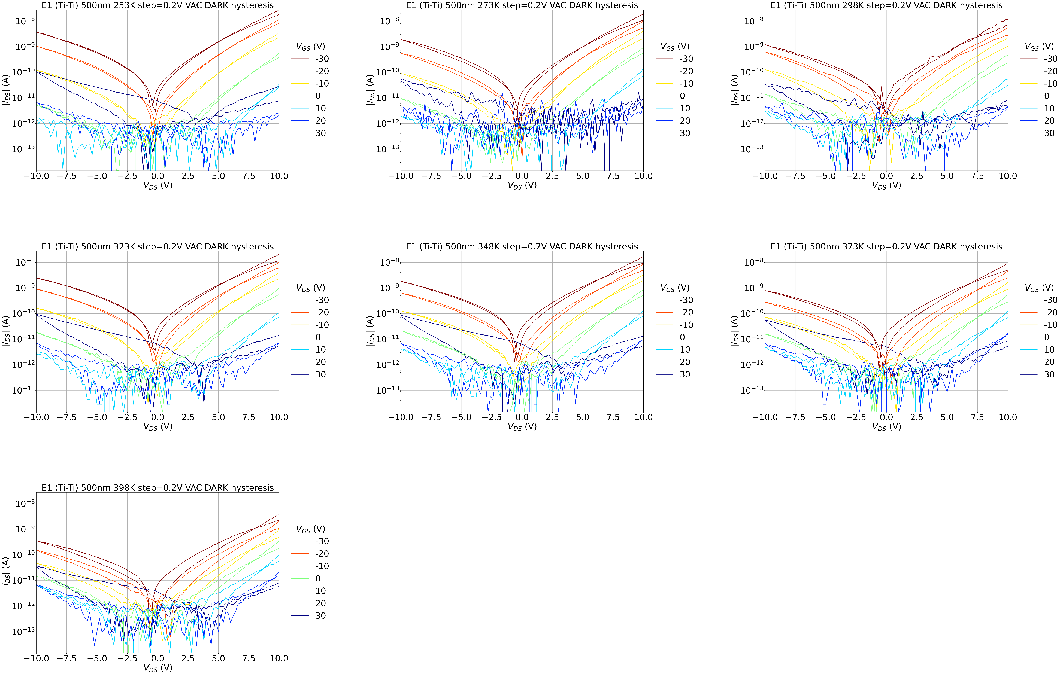
500nm Ti-Ti E1 T sweep

Slide 9
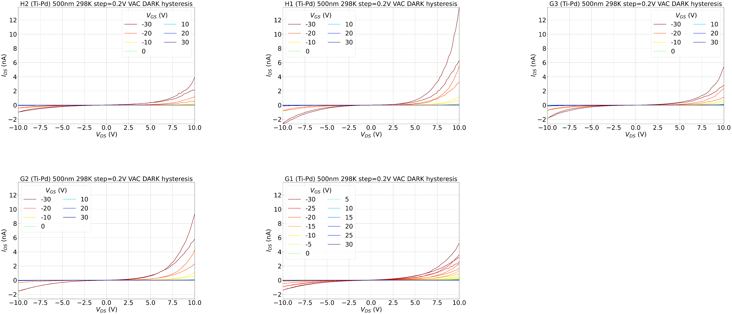
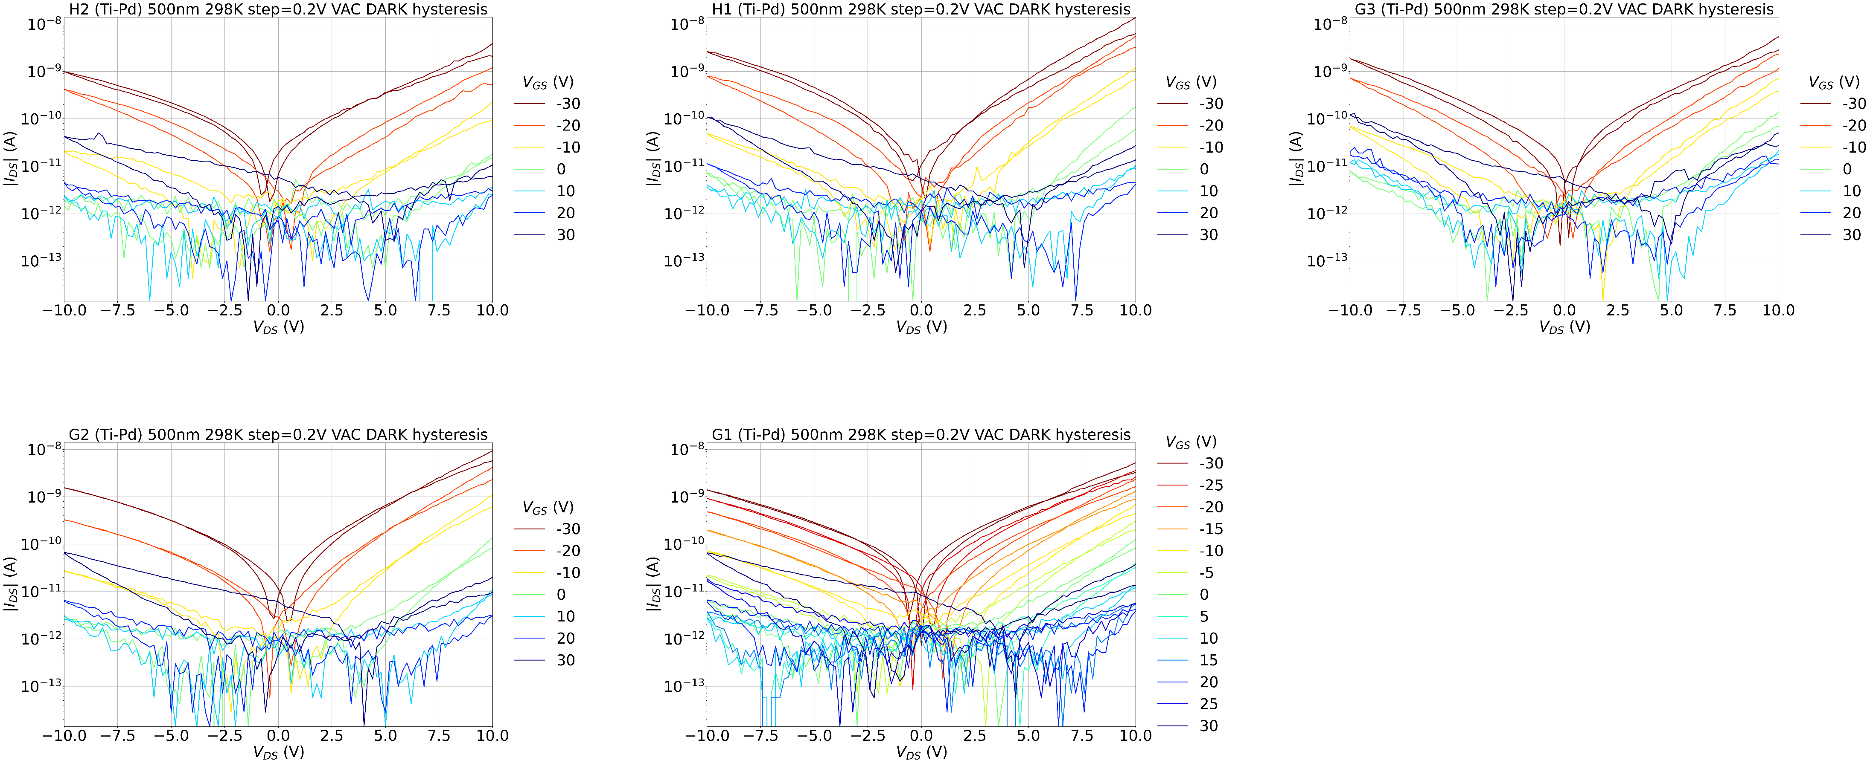
500nm Ti-Pd 298K

Slide 10
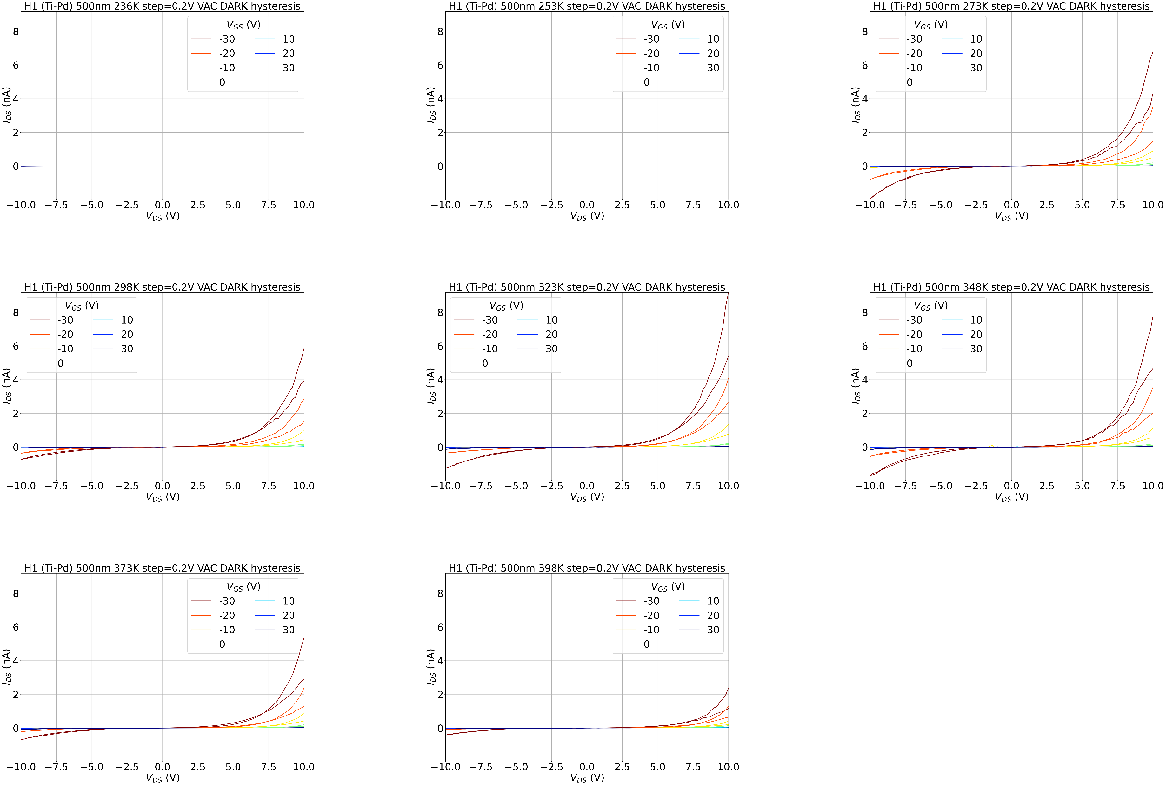
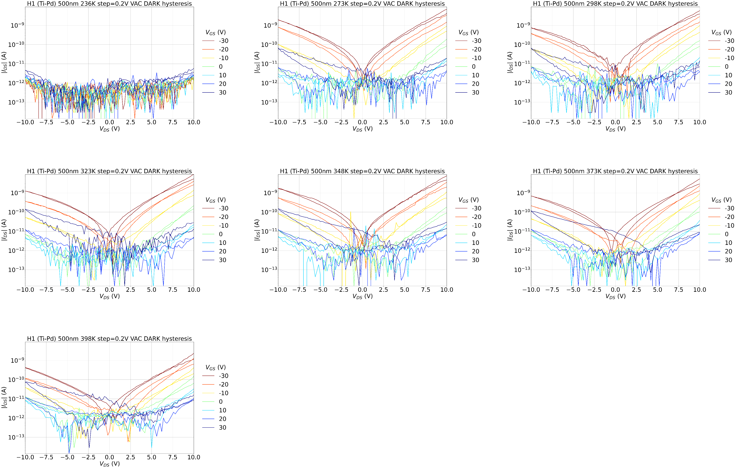
500nm Ti-Pd H1 T sweep

Slide 11
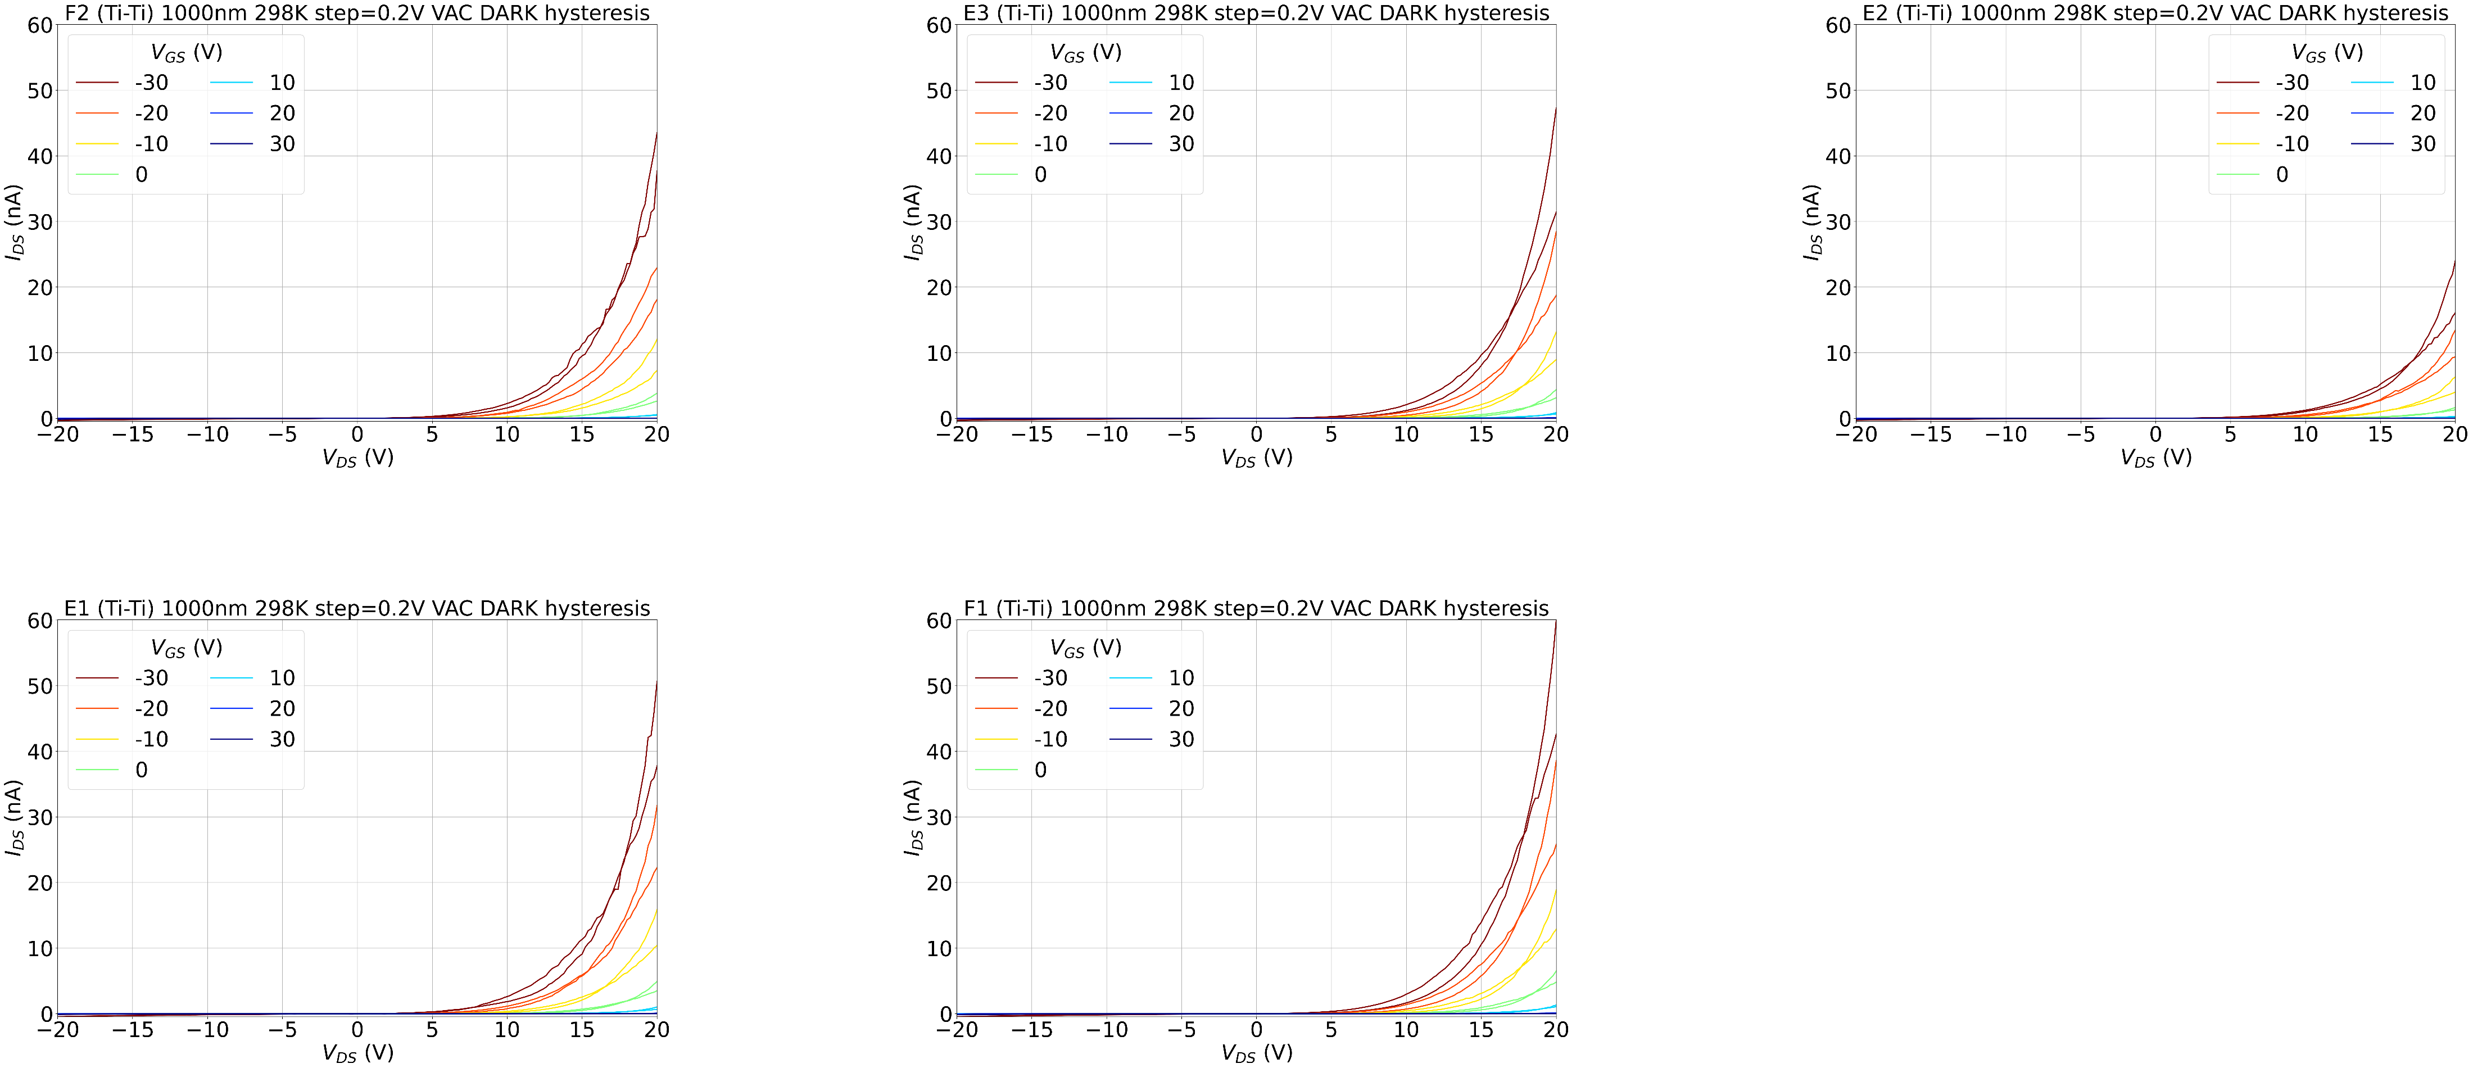
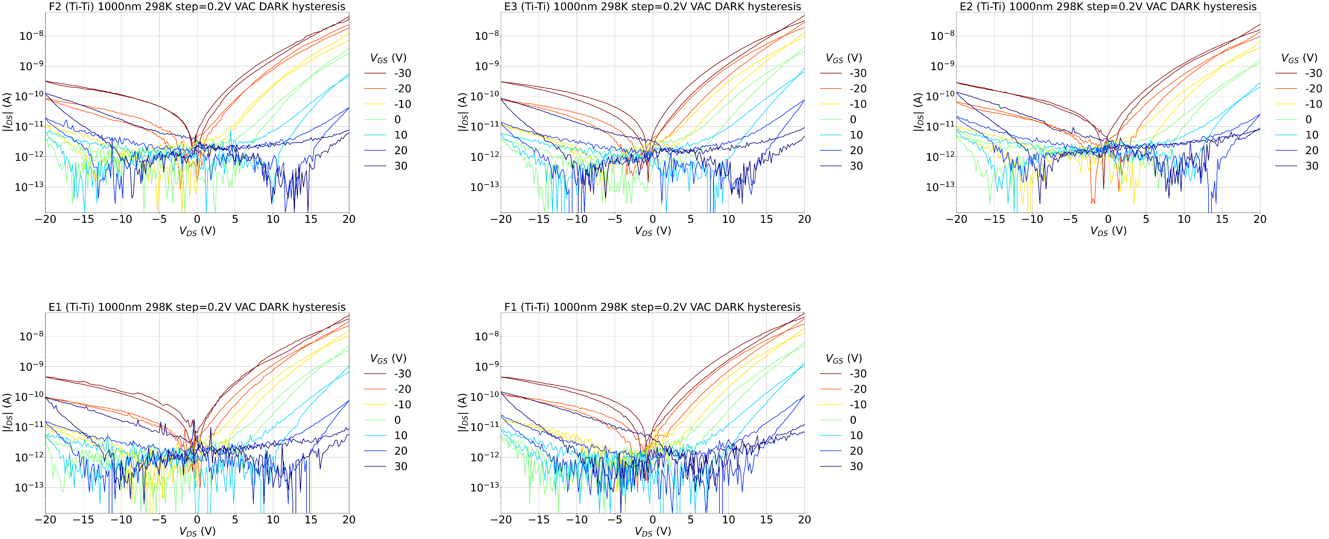
1000nm Ti-Ti 298K

Slide 12
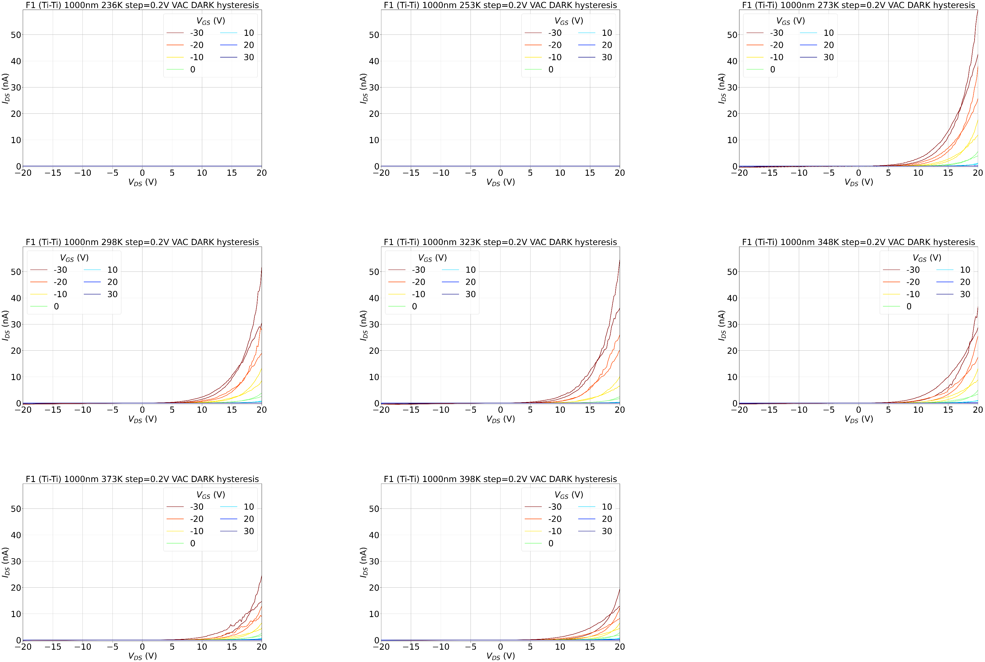
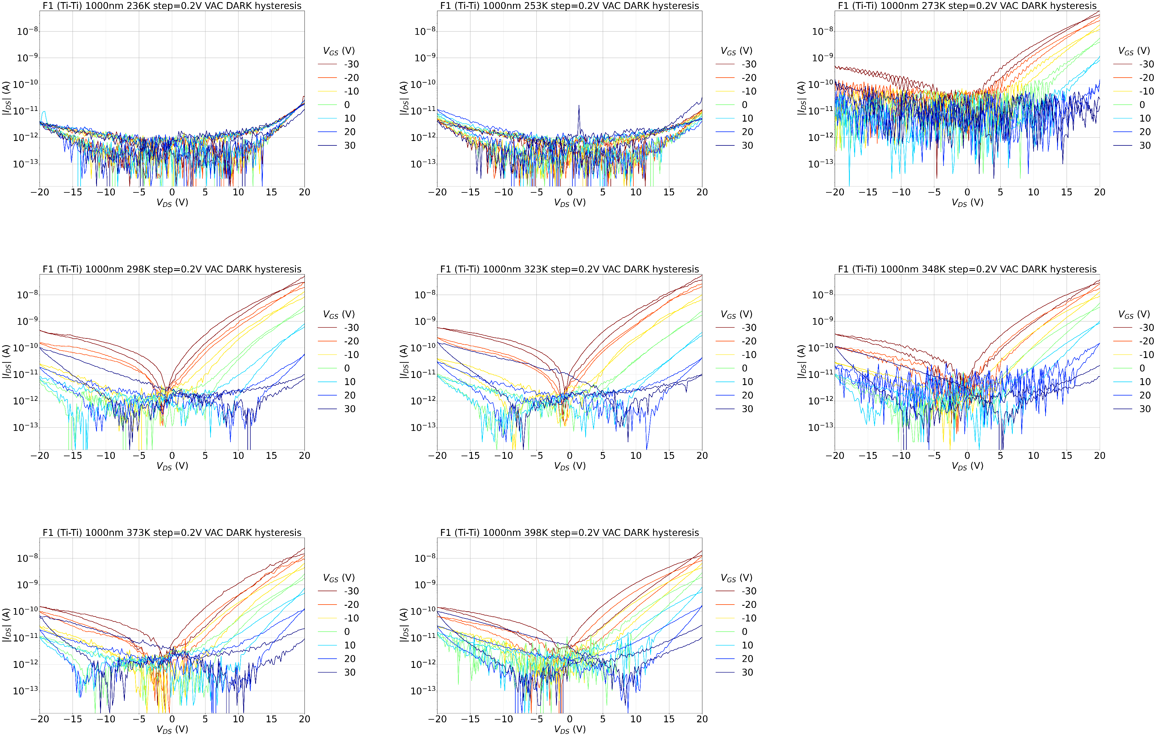
1000nm Ti-Ti F1 T sweep

Slide 13
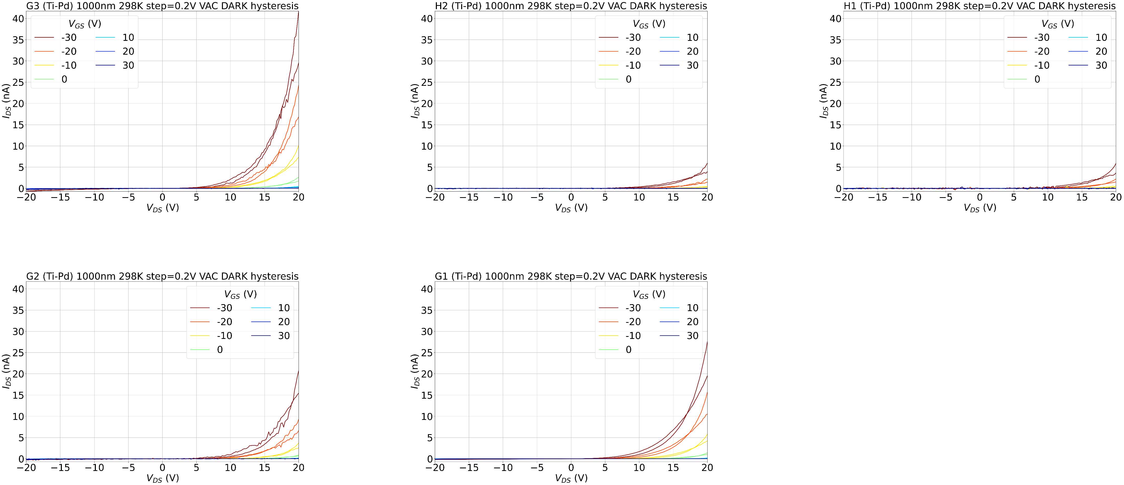
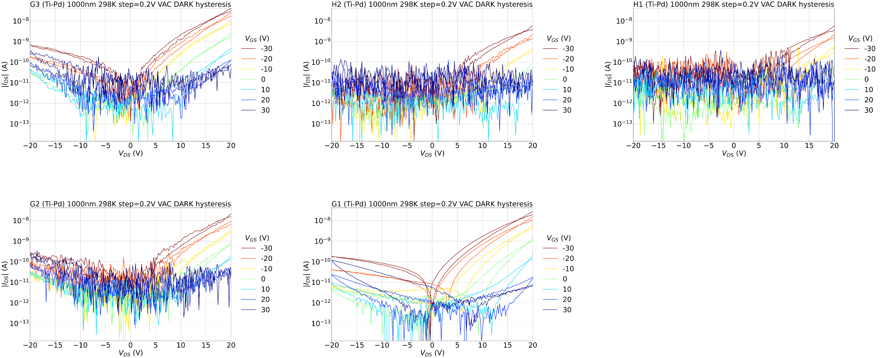
1000nm Ti-Pd 298K

Slide 14
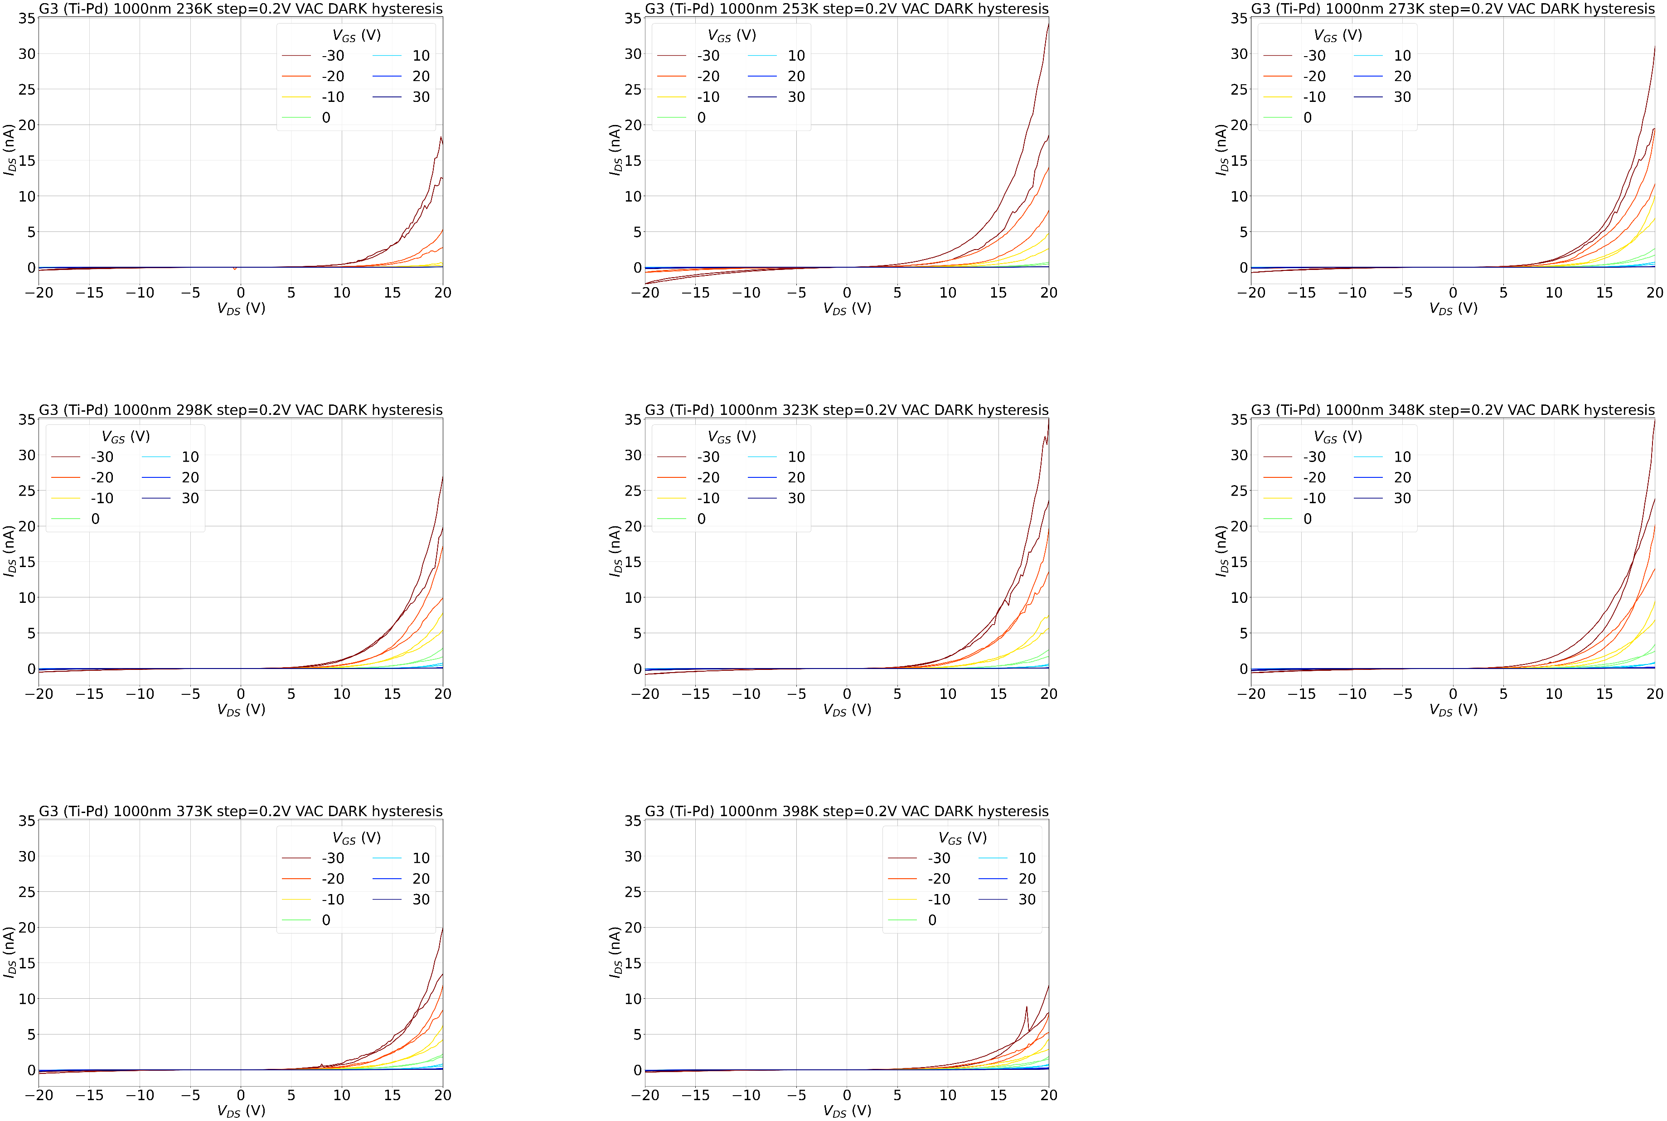
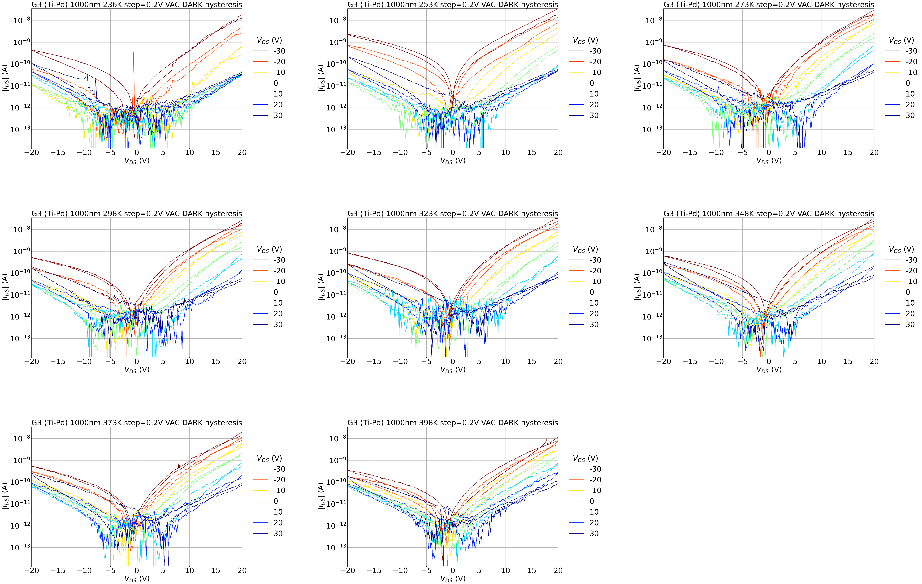
1000nm Ti-Pd G3 T sweep

Slide 15
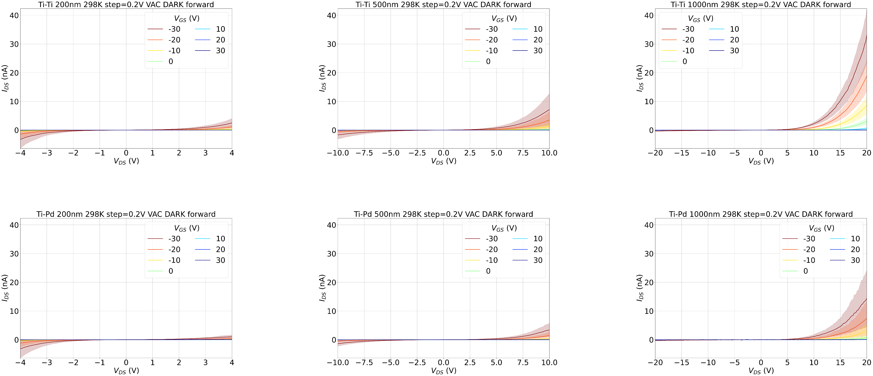
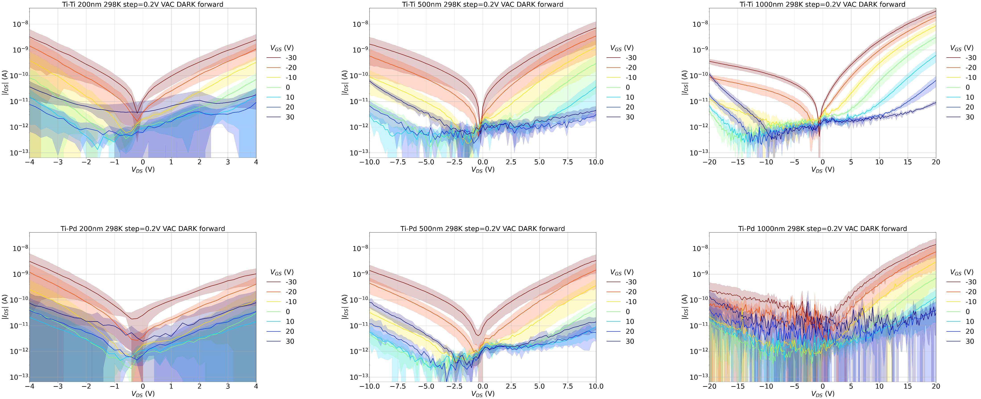
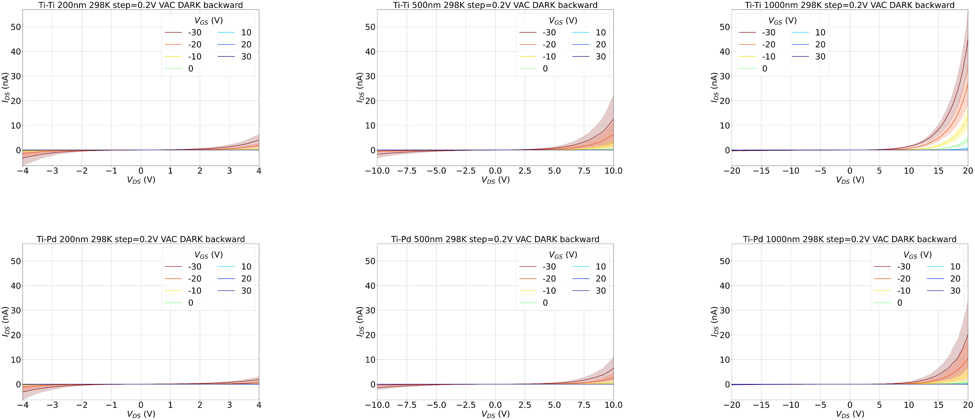
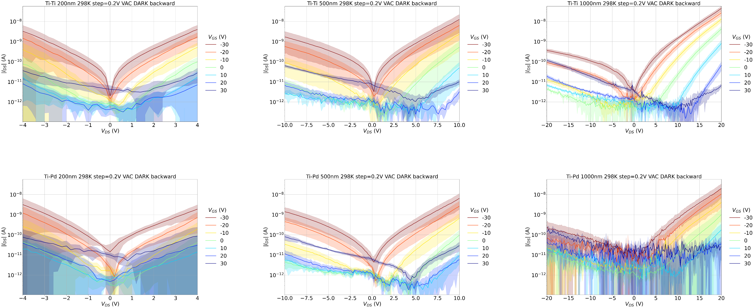
Mean ± σ 298K
FORWARD
Ti-Ti
Ti-Pd
BACKWARD
Ti-Ti
Ti-Pd

Slide 16
Idvg

Slide 17
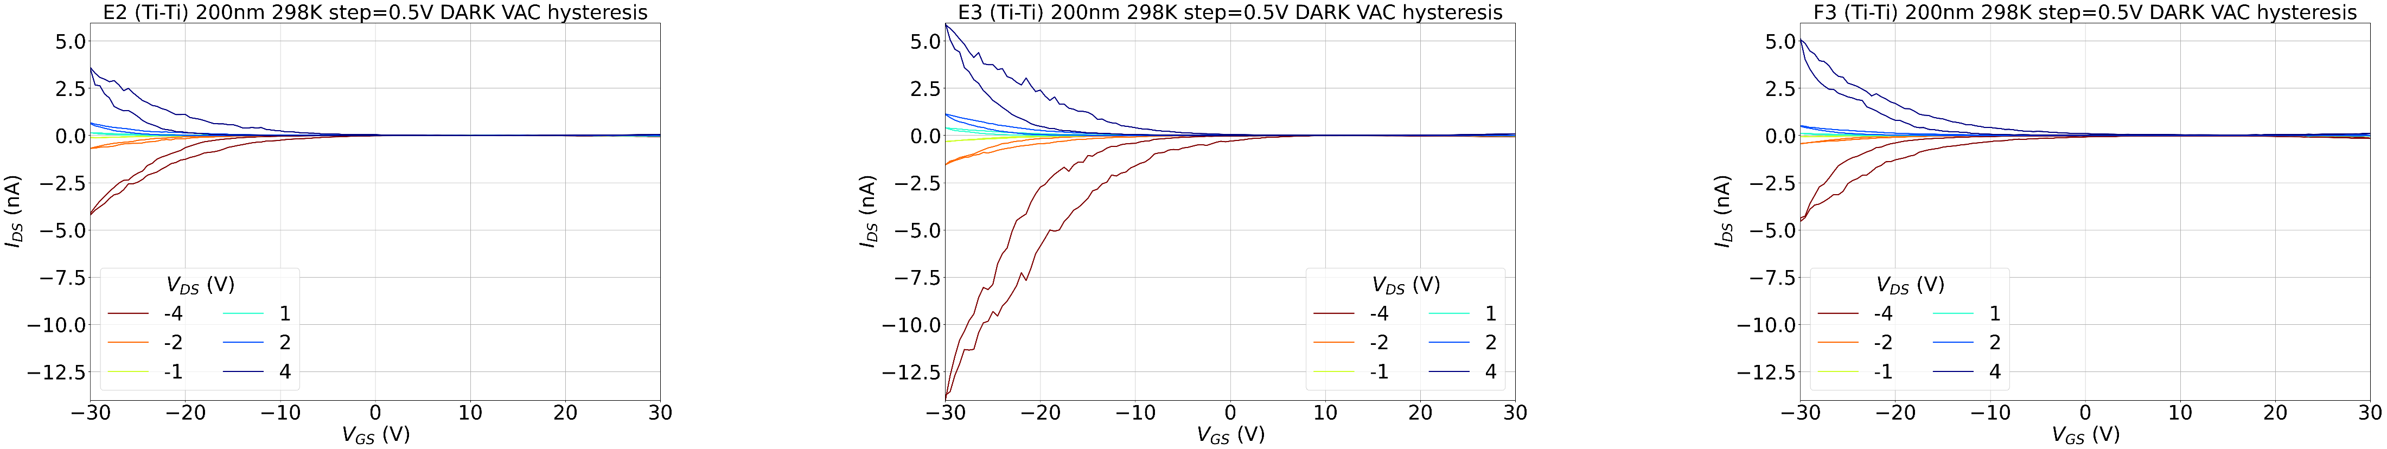
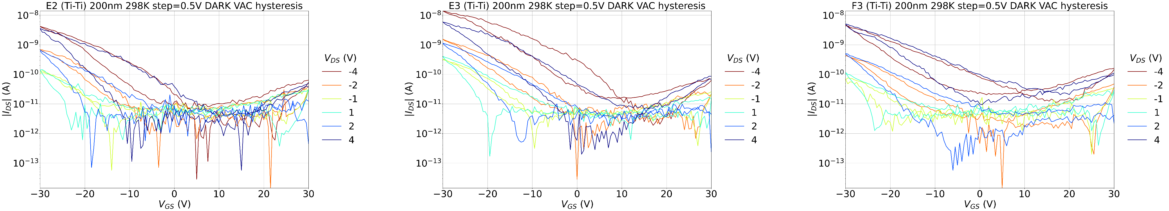
Ti-Ti 200nm @298K
* Falta F2 que està en fitxers separats

Slide 18
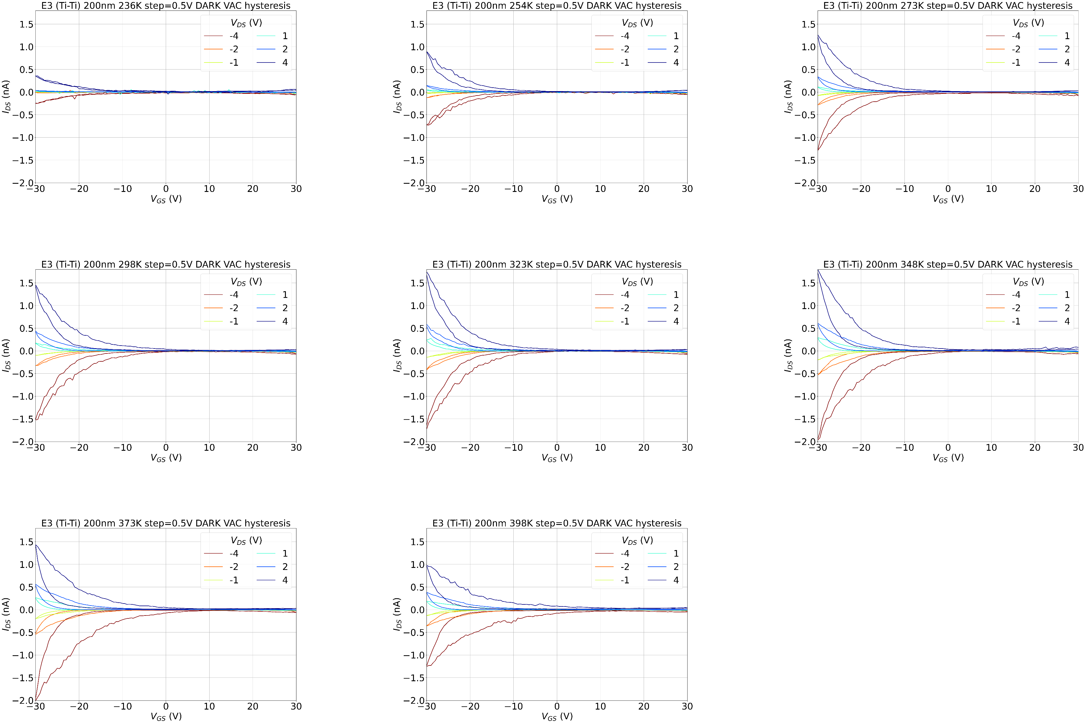
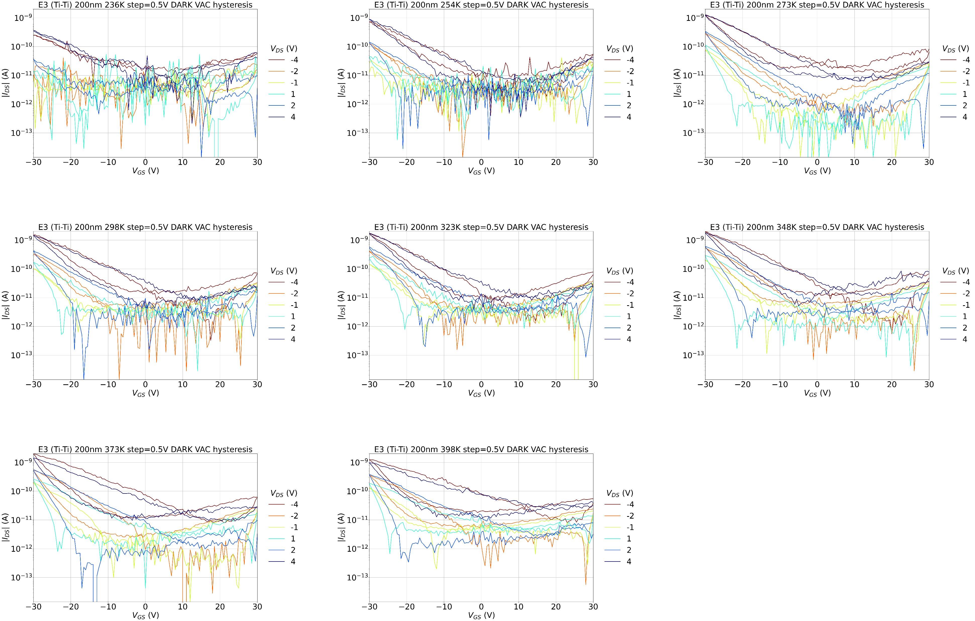
E3 (Ti-Ti) 200nm T sweep

Slide 19
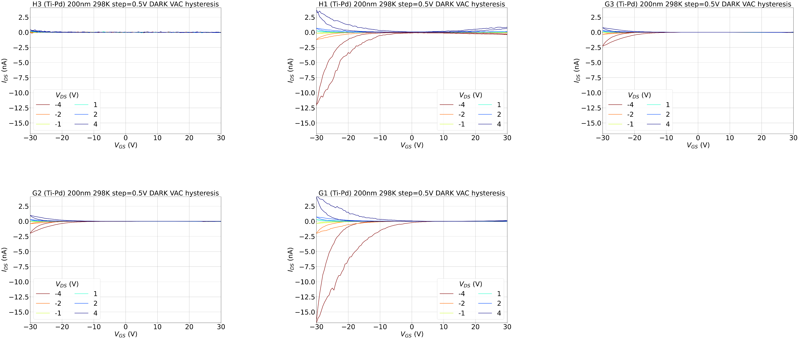
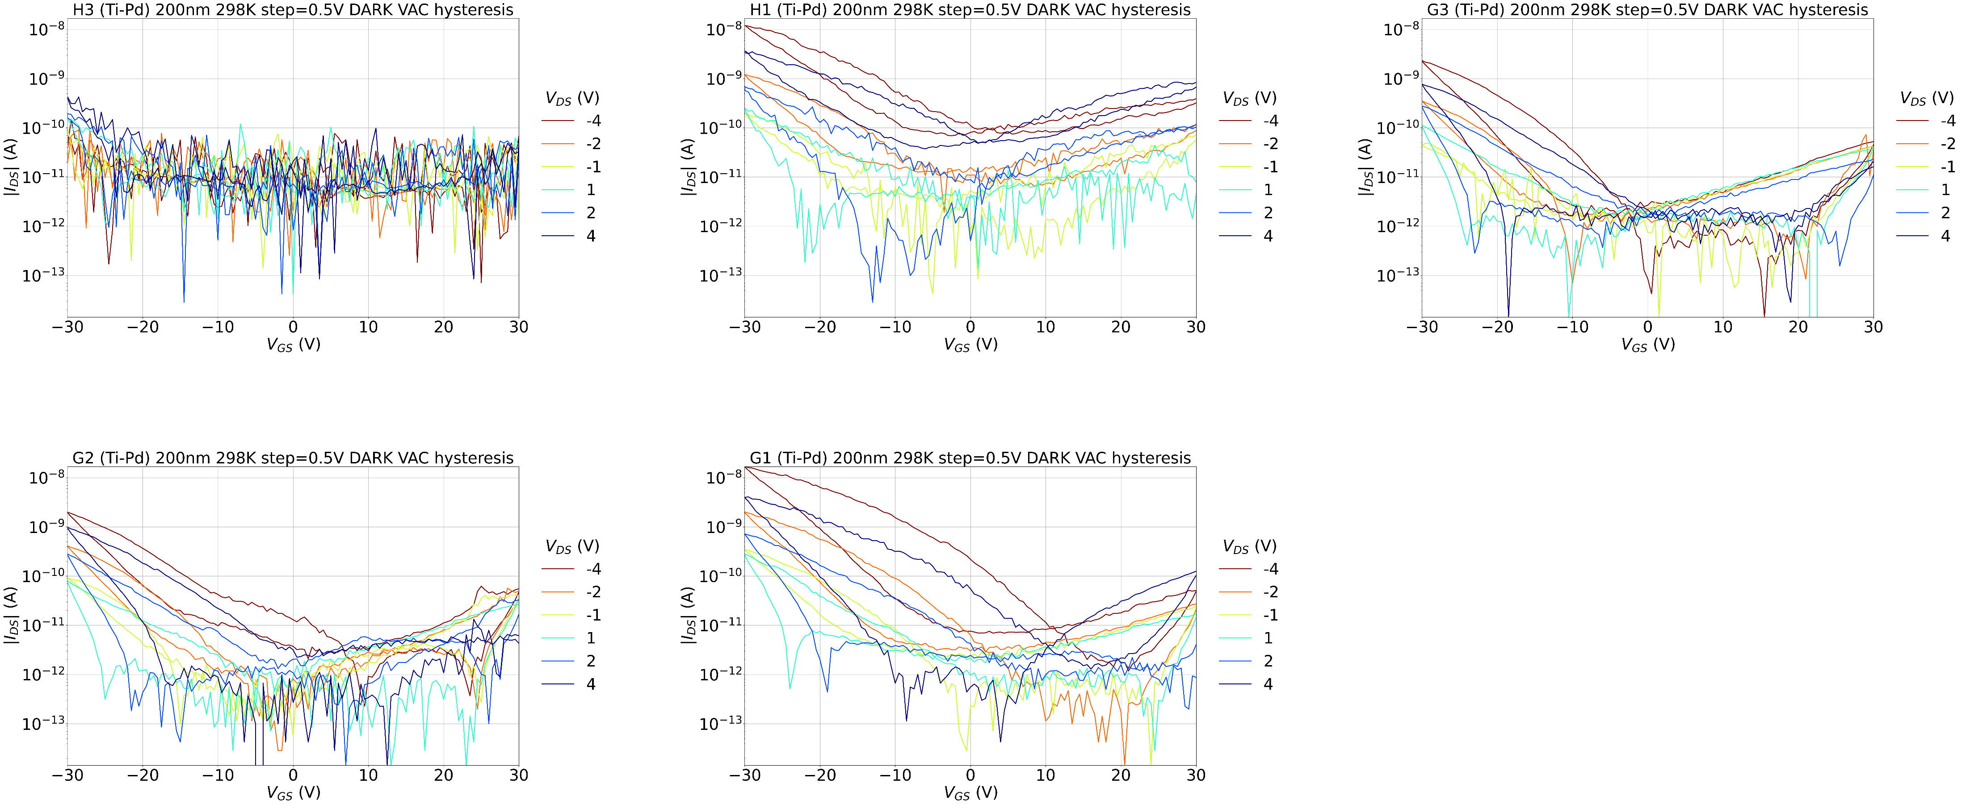
Ti-Pd 200nm @298K
* H3 el deixem fora per fer la mitjana

Slide 20
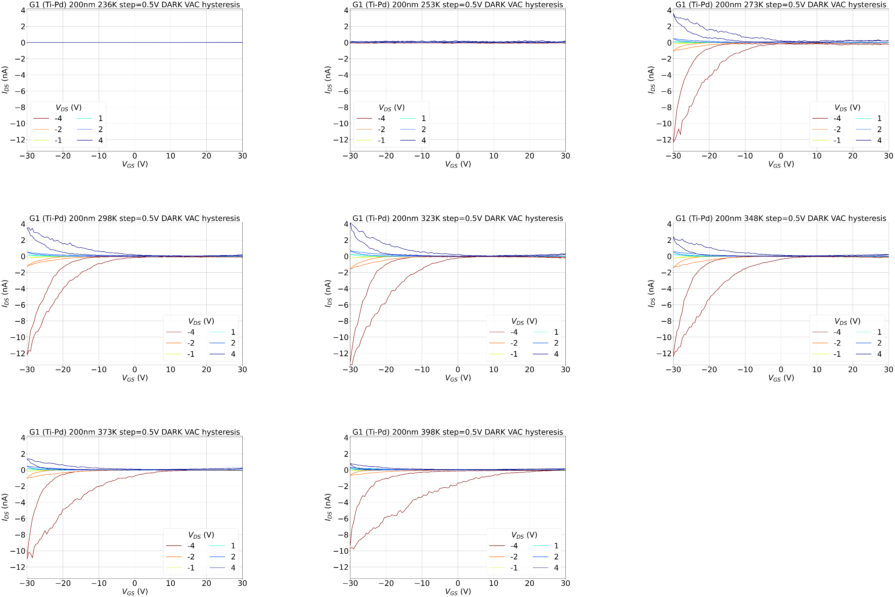
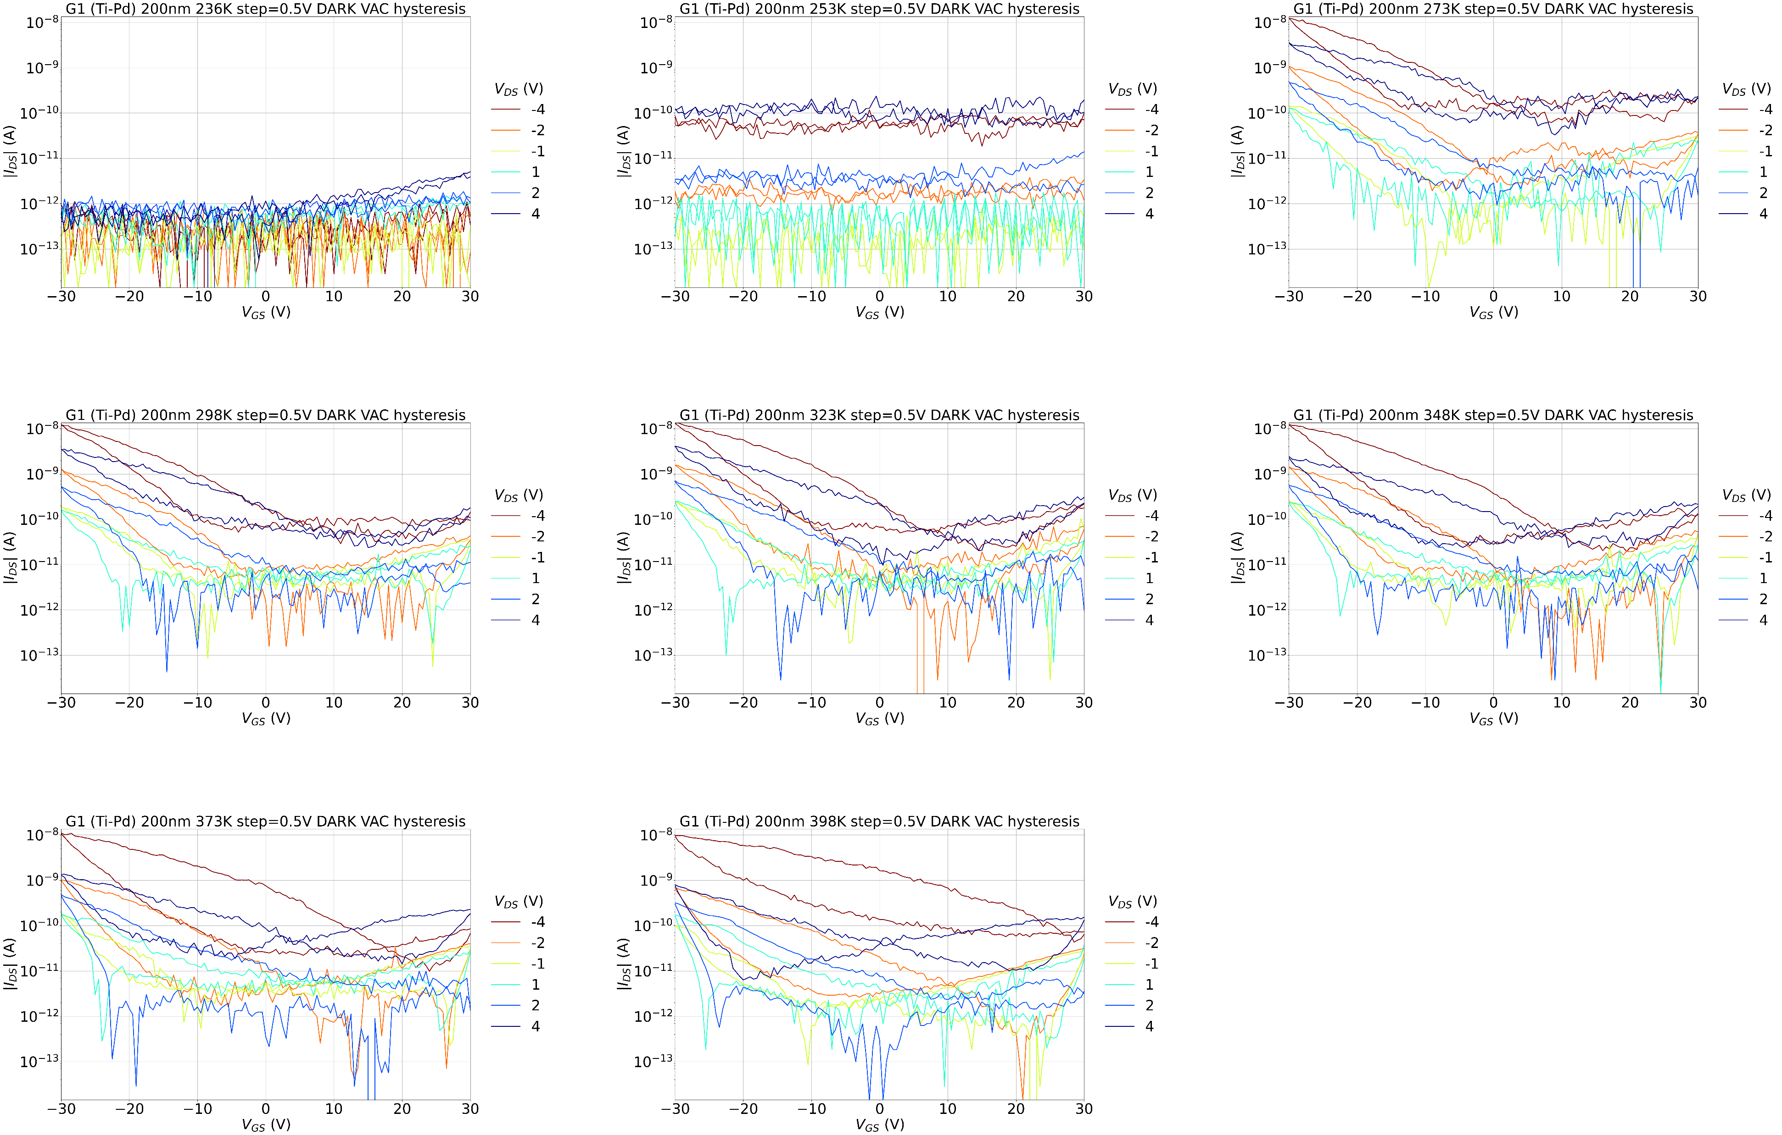
G1 (Ti-Pd) 200nm T sweep

Slide 21
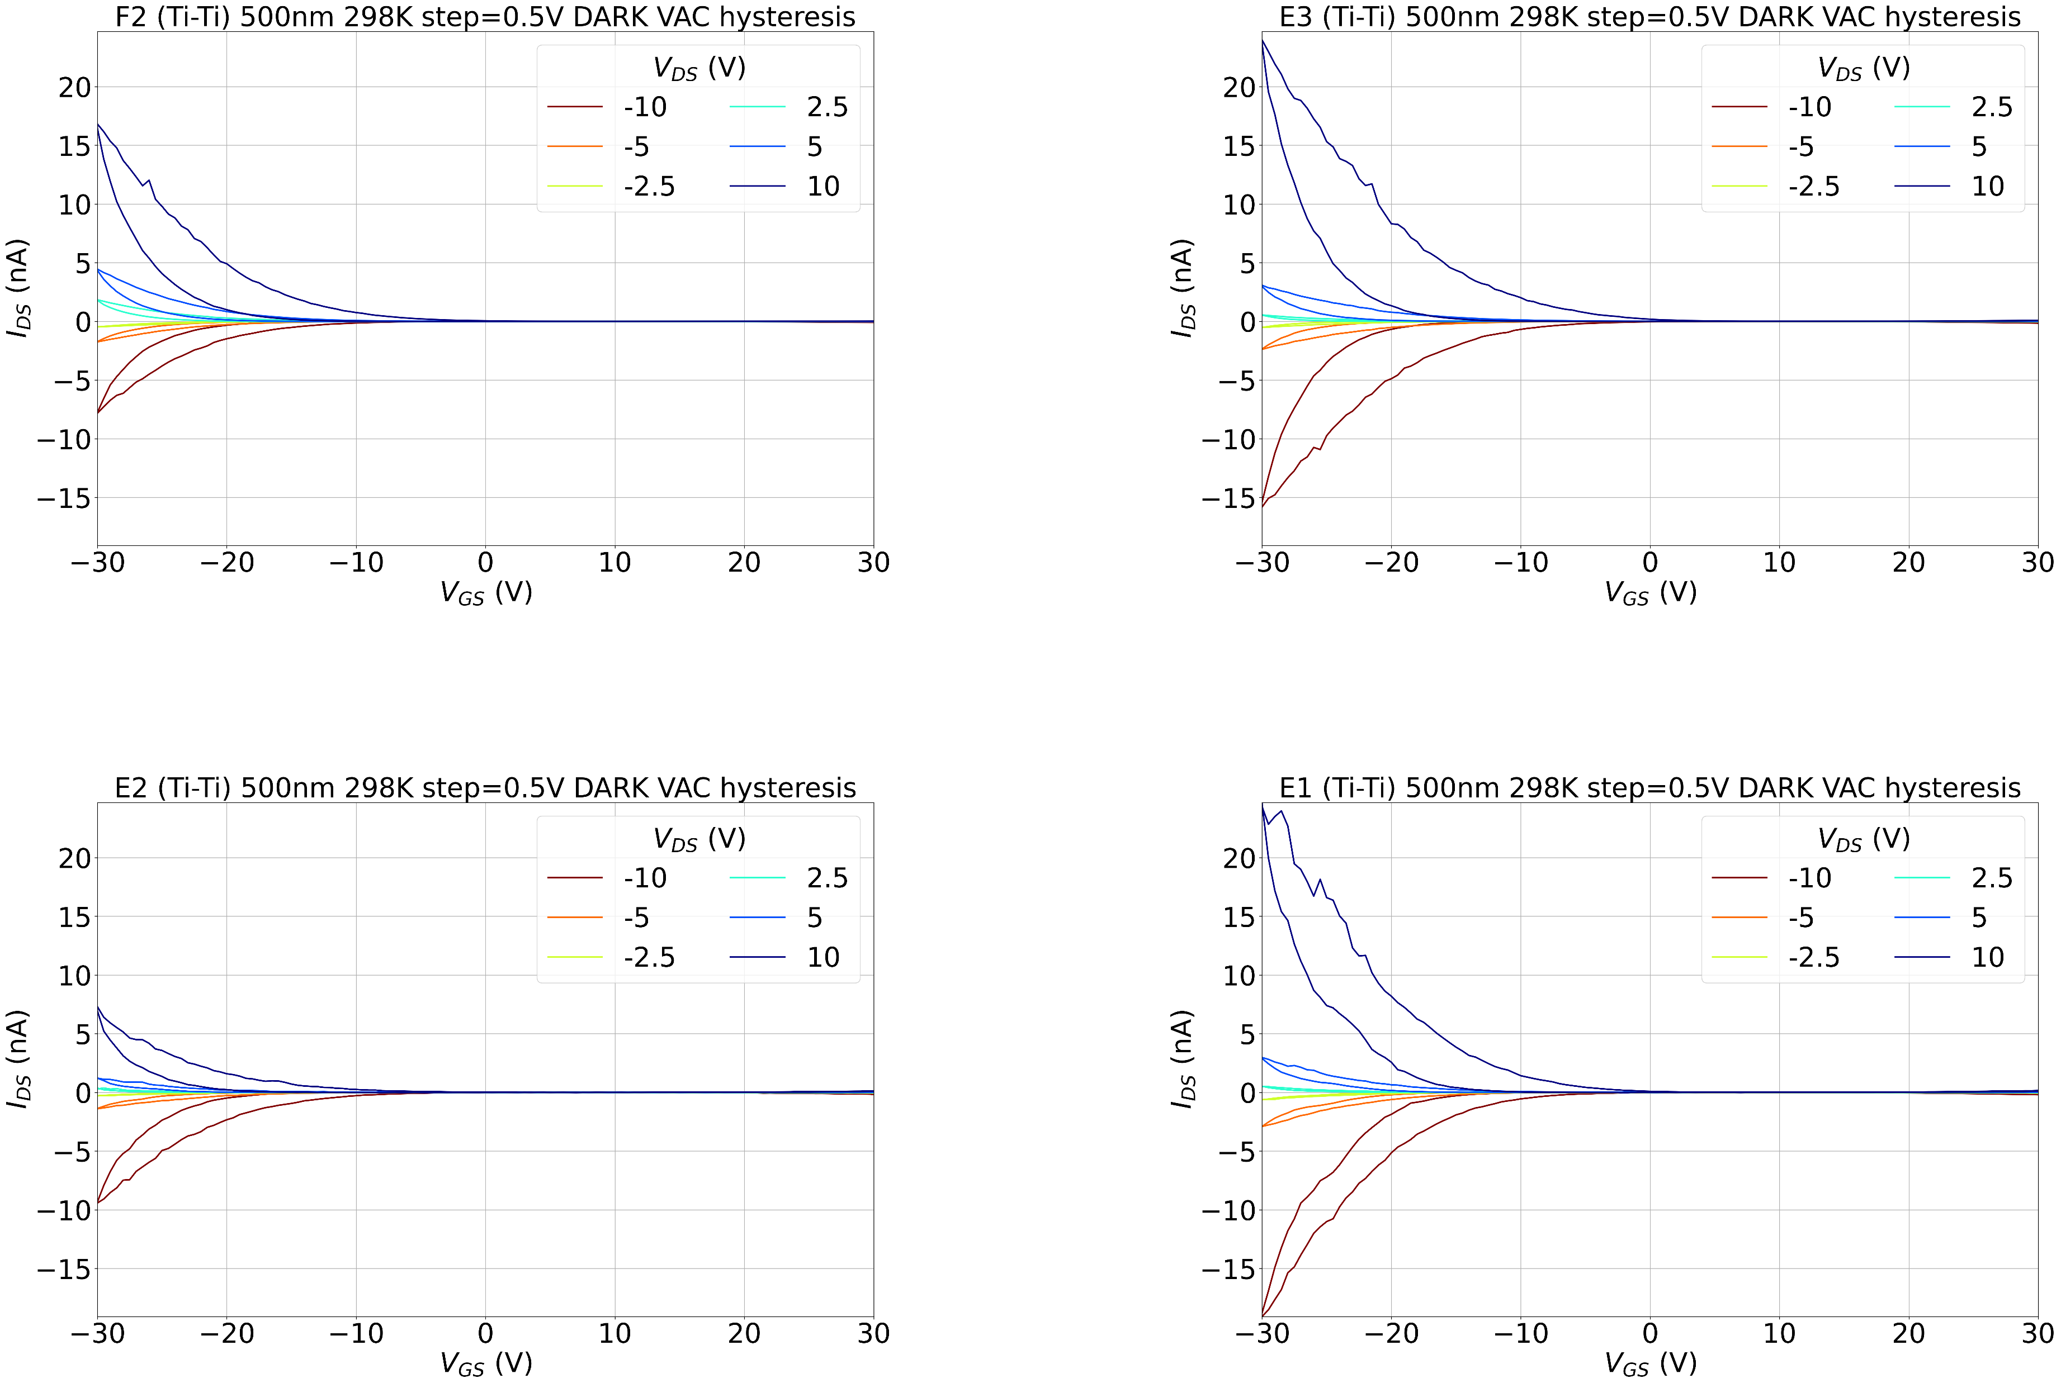
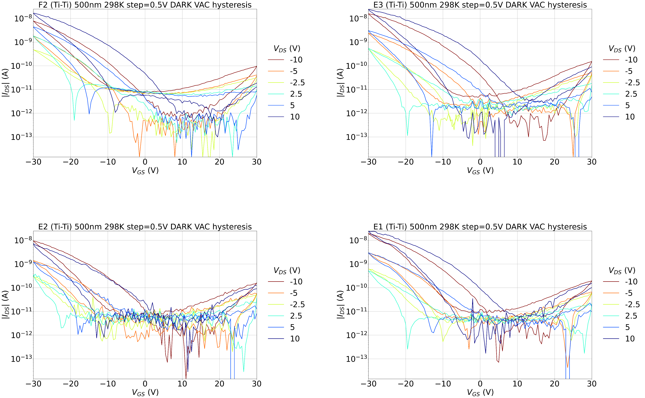
Ti-Ti 500nm @298K

Slide 22
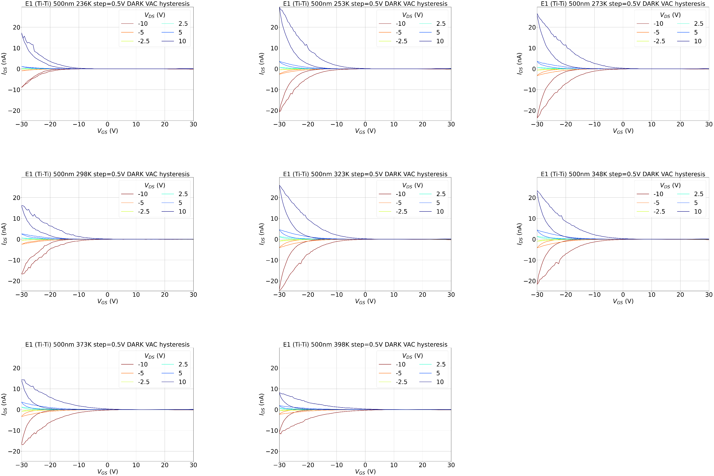
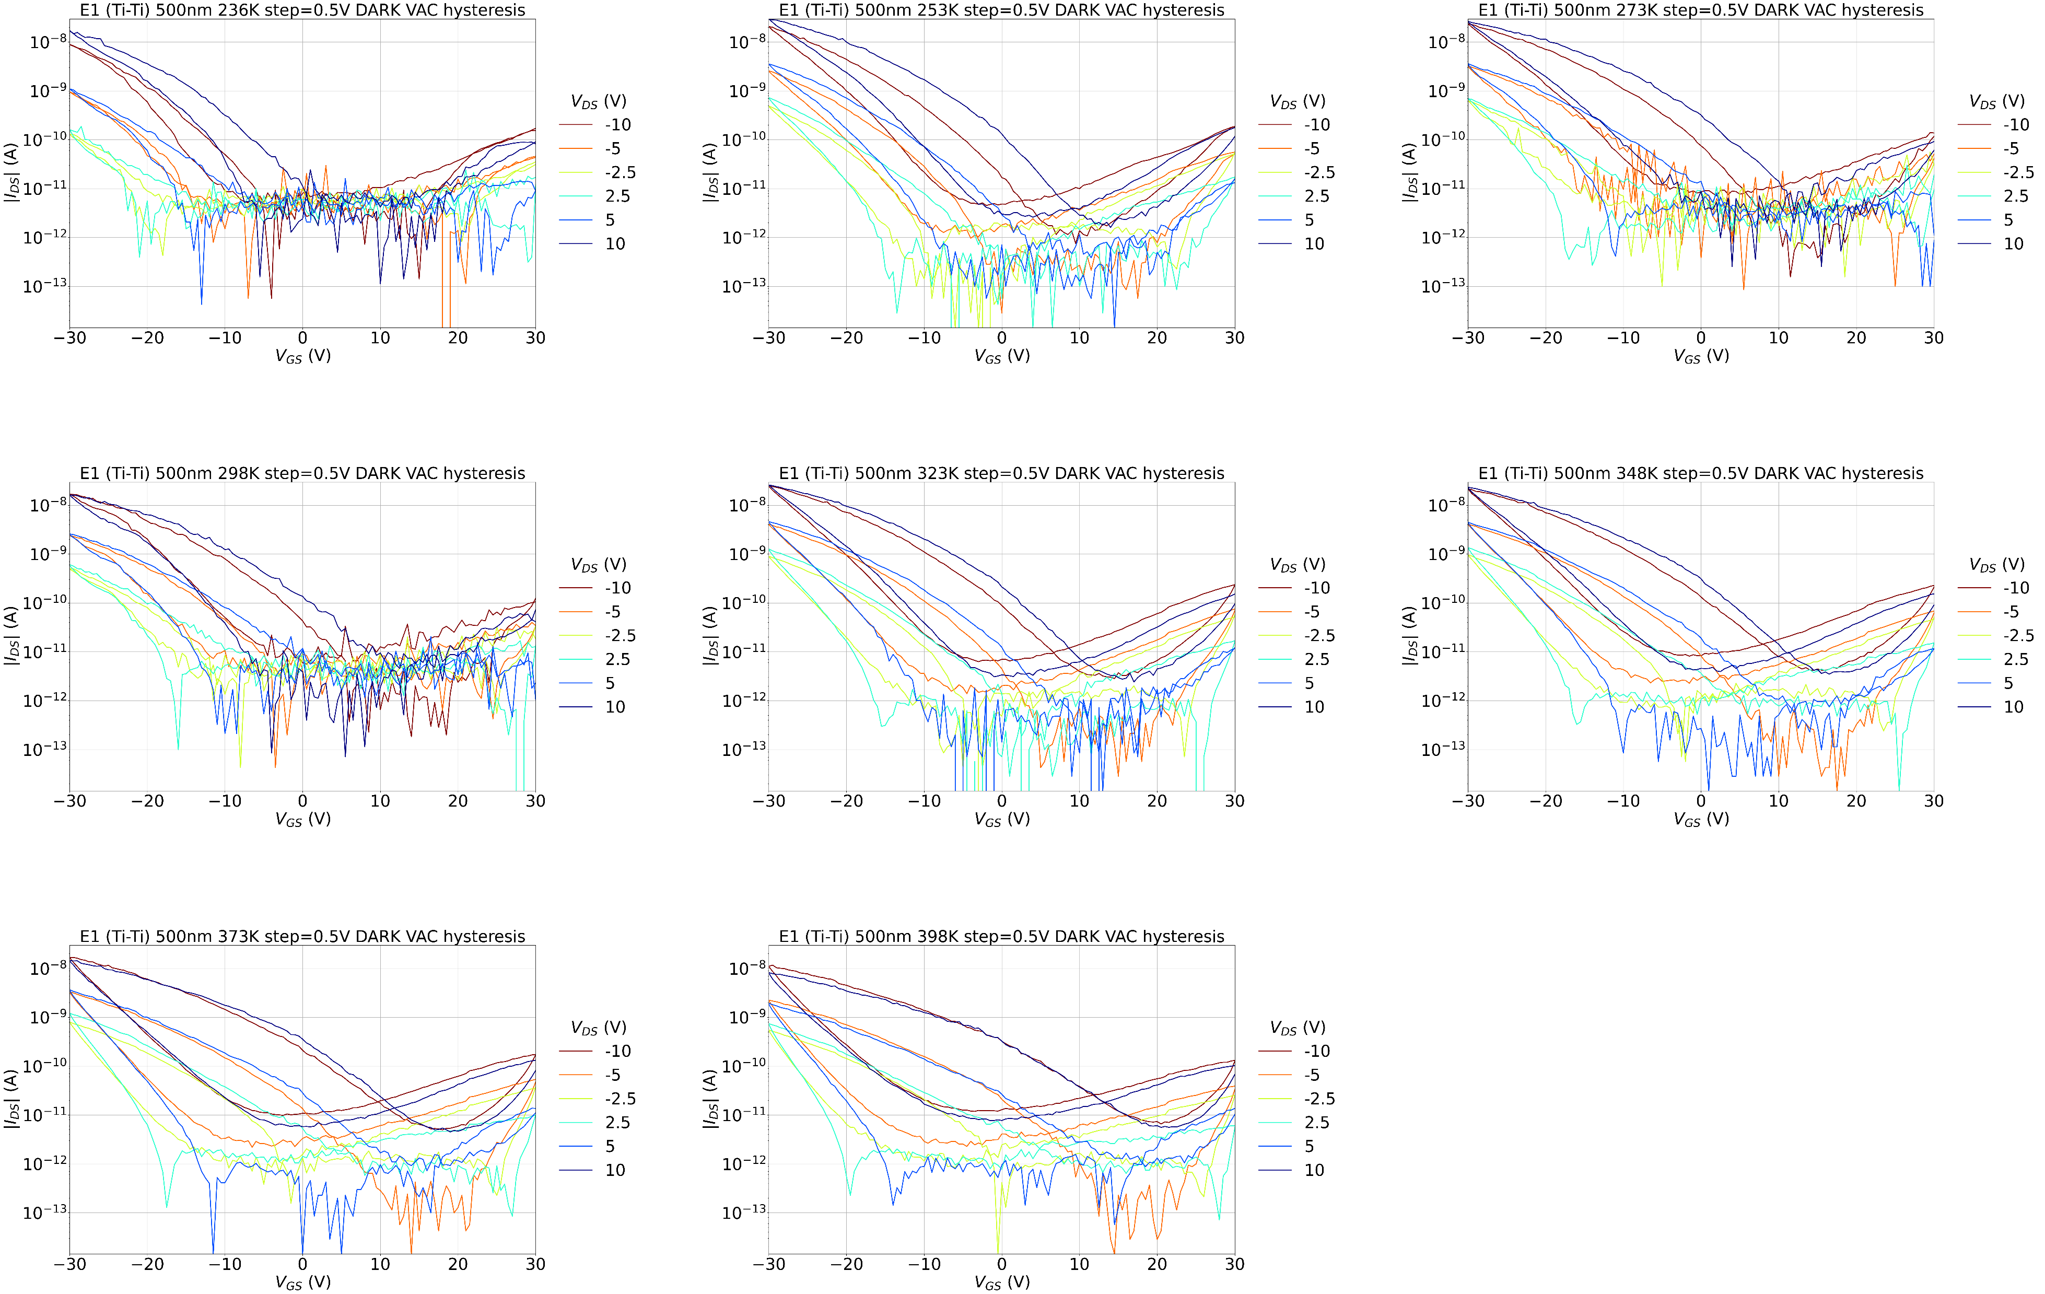
E1 (Ti-Ti) 500nm T sweep

Slide 23
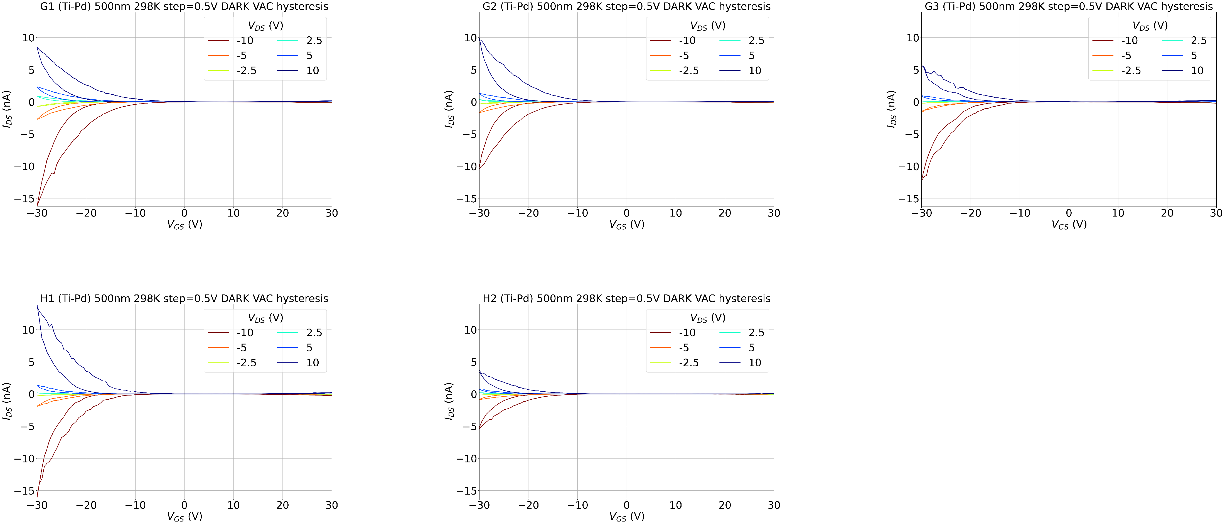
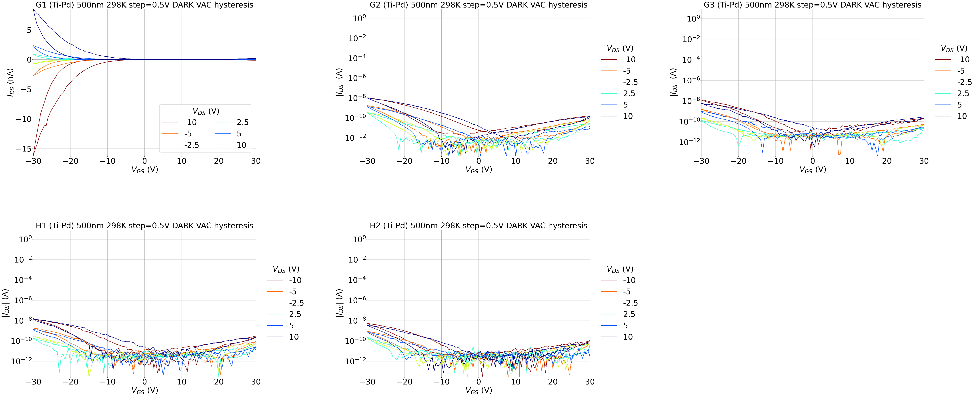
Ti-Pd 500nm @298K

Slide 24
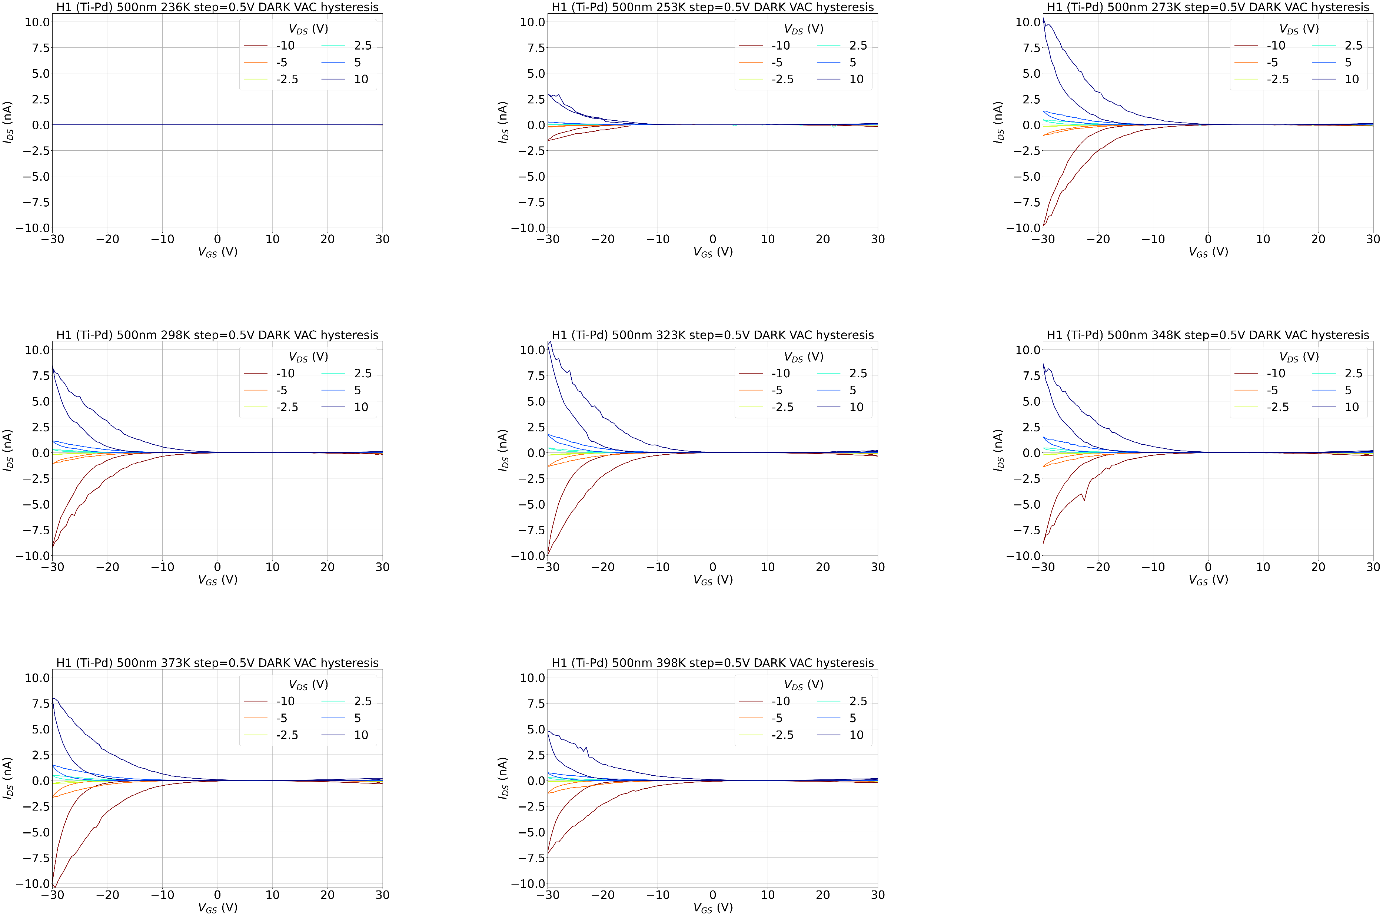
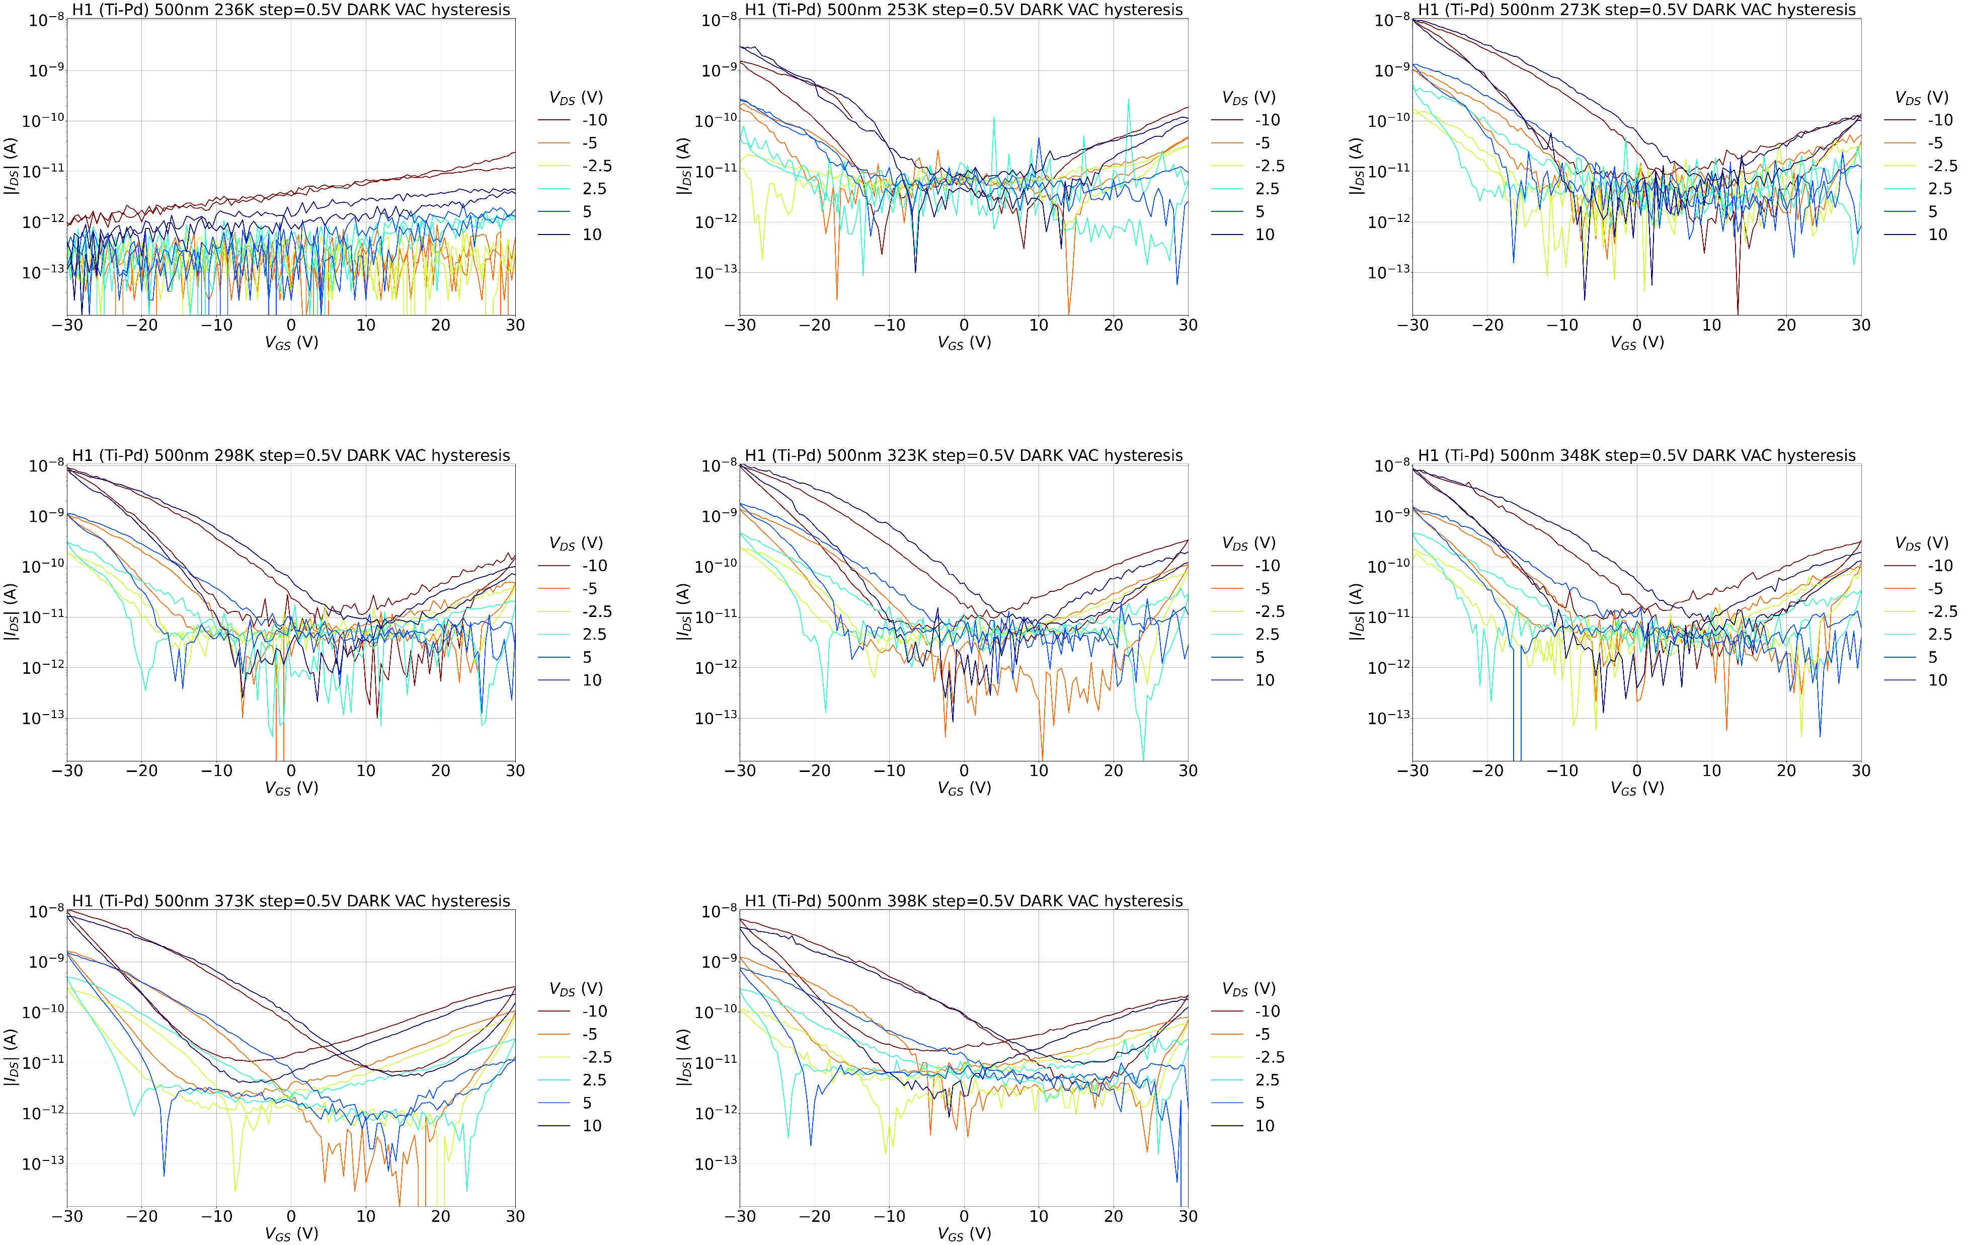
H1 (Ti-Pd) 500nm T sweep

Slide 25
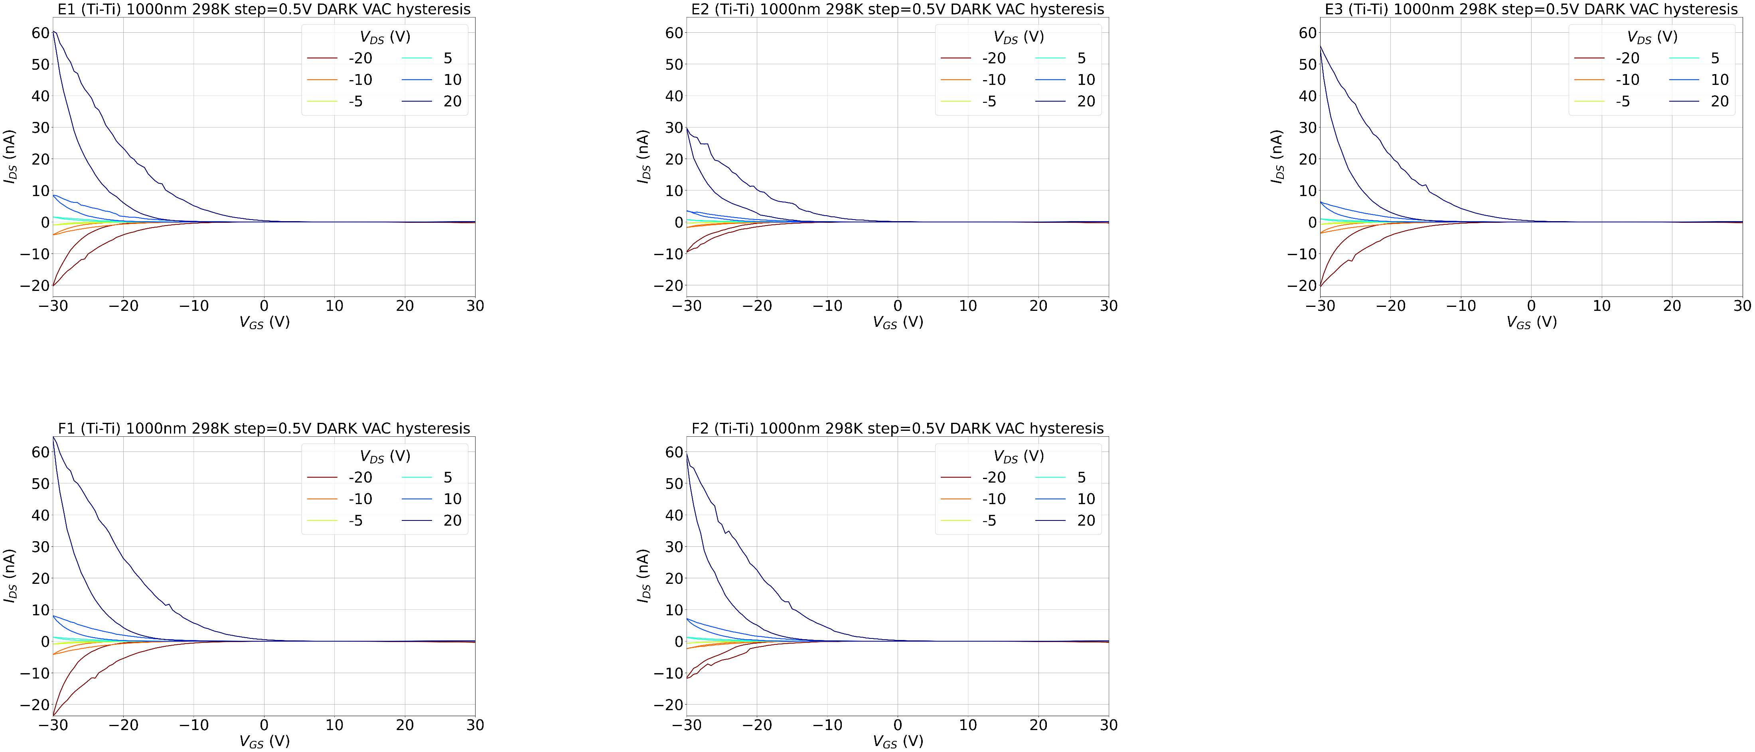
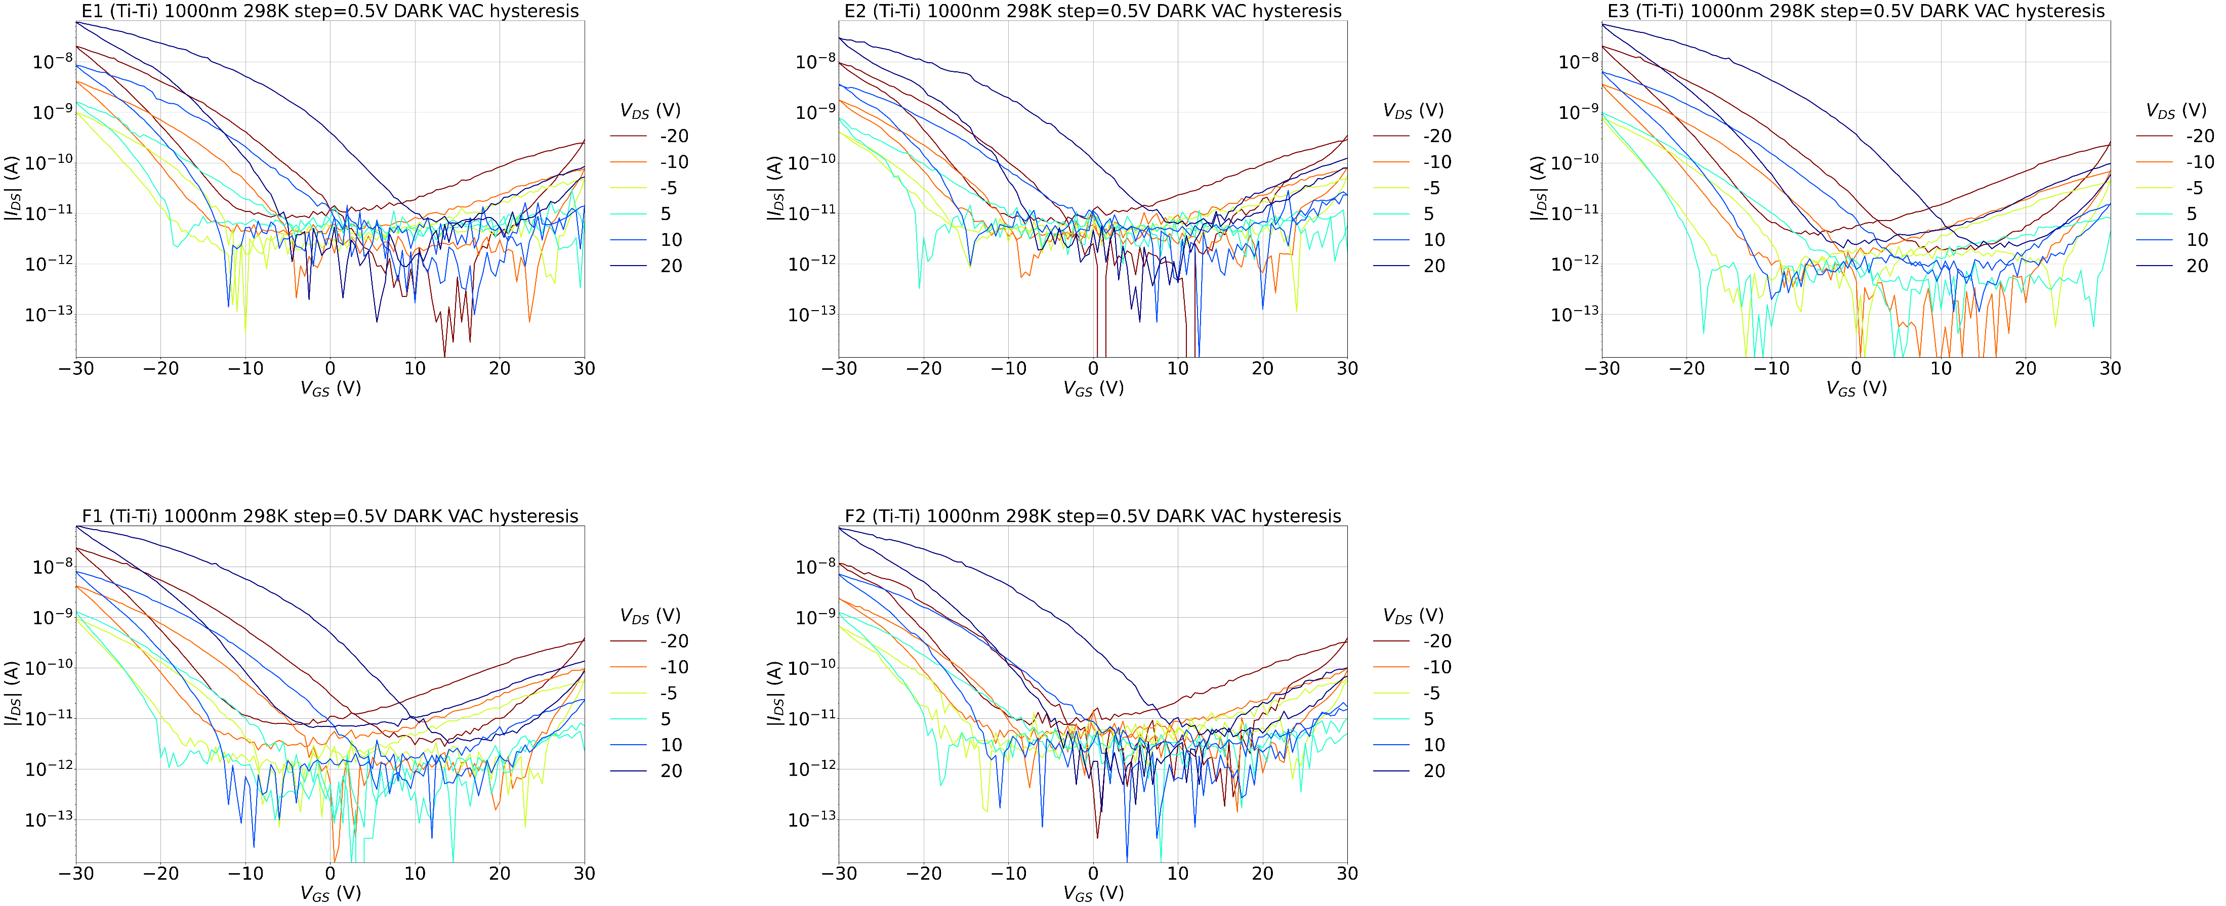
Ti-Ti 1000nm @298K

Slide 26
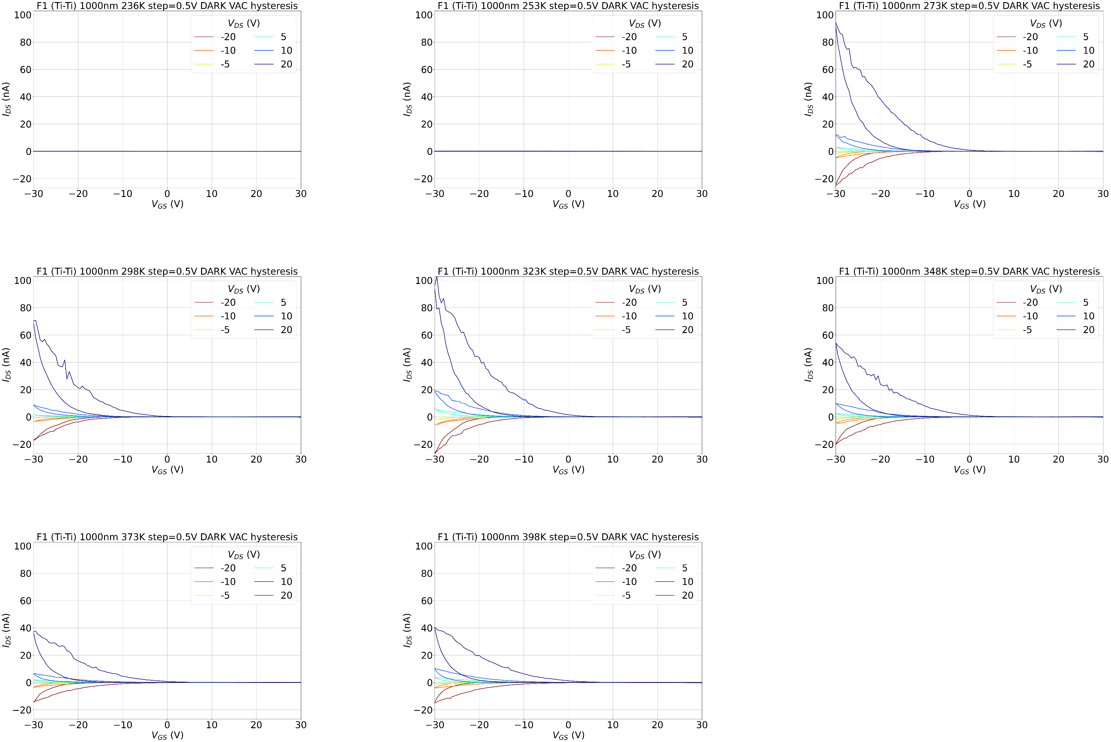
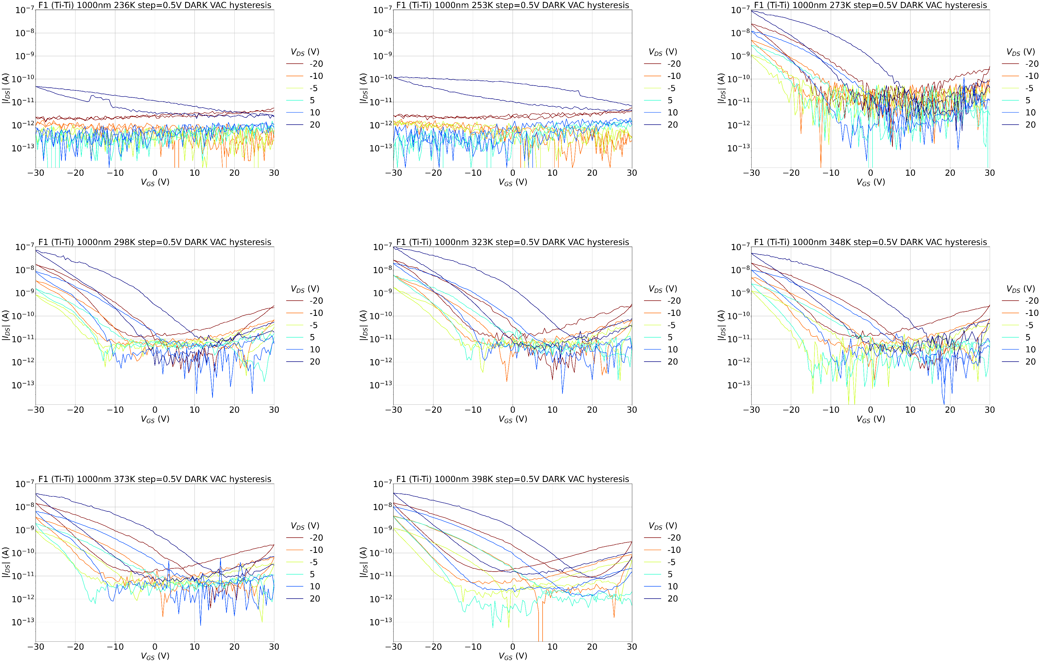
F1 (Ti-Ti) 1000nm T sweep

Slide 27
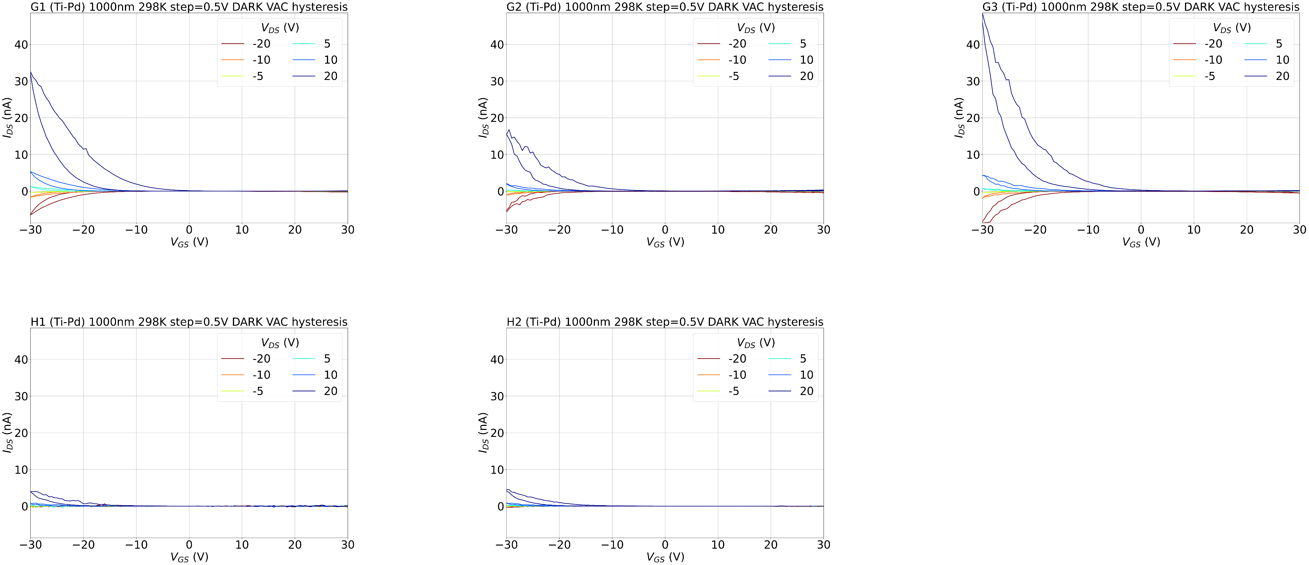

Ti-Pd 1000nm @298K

Slide 28


G3 (Ti-Pd) 1000nm T sweep

Slide 29




Mean ± σ 298K
FORWARD
Ti-Ti
Ti-Pd
BACKWARD
Ti-Ti
Ti-Pd

Slide 30
FET parameters

Slide 31

Ids_on Ti-Ti

Slide 32

Ids_on Ti-Pd

Slide 33

Ids_off Ti-Ti

Slide 34

Ids_off Ti-Pd

Slide 35

Ratio Ti-Ti

Slide 36

Ratio Ti-Pd

Slide 37

V_th Ti-Ti

Slide 38


V_th Ti-Pd

Slide 39

V_th box plot
Ti-Ti
Fw
Bw
Ti-Pd
Fw
Bw

Slide 40

SS Ti-Ti

Slide 41

SS Ti-Pd

Slide 42

μ_lin Ti-Ti
params_mu_lin_TiTi

Slide 43

μ_lin Ti-Pd

Slide 44

μ_lin box plot
Ti-Ti
Fw
Bw
Ti-Pd
Fw
Bw

Slide 45

μ_sat Ti-Ti

Slide 46


μ_sat Ti-Pd

Slide 47

μ_sat box plot
Ti-Ti
Fw
Bw
Ti-Pd
Fw
Bw

Slide 48


μ_RW vs Vds

Slide 49

N_it Ti-Ti
Nit_SS fw
Nit_SS bw
Nit_Delta

Slide 50

N_it Ti-Pd
Nit_SS fw
Nit_SS bw
Nit_Delta

Slide 51




Idvg of devices used for RW analysis

Slide 52






RW vs L

Slide 53




Rc vs Vds mirar vgs -30,-20 y vds 4

Slide 54
Raman

Slide 55


Idvd G3 (Ti-Pd) 1000nm 298K Light On vs Light Off

Slide 56




Idvg G3 (Ti-Pd) 1000nm 298K Light On vs Light Off

Slide 57


Idvg G1 (Ti-Pd) 1000nm 298K Light On vs Light Off

Slide 58


Id vs Time

